Slide 1

A Guide to Parliamentary Procedure
August 17, 2017
Bill Barry
http:billbarry.net
billbarry21214@gmail.com

Slide 2

Is what you are doing
Building up your union?
or Tearing Down Your Union?
There are no other choices.

Slide 3
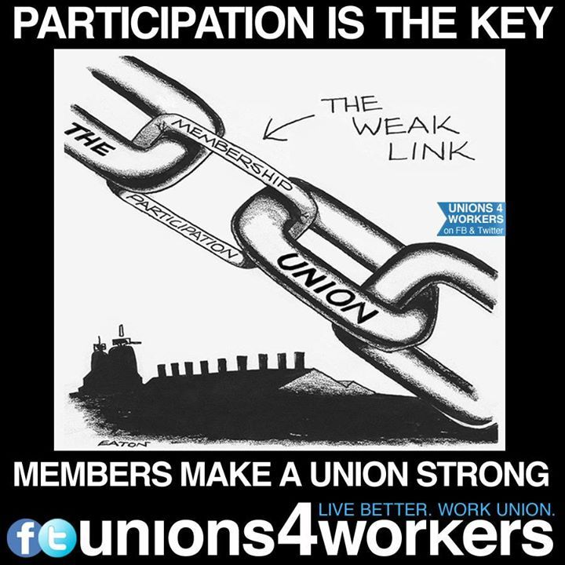
The goal of parliamentary procedure is to
encourage membership enthusiasm
and confidence in their union democracy
so they are stronger union members
. . . even if they don’t win every time

Slide 4
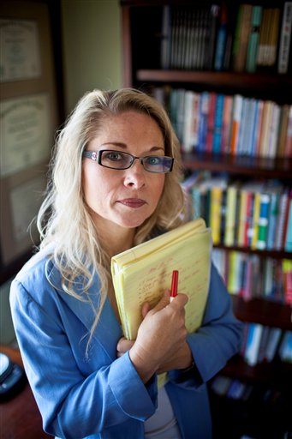
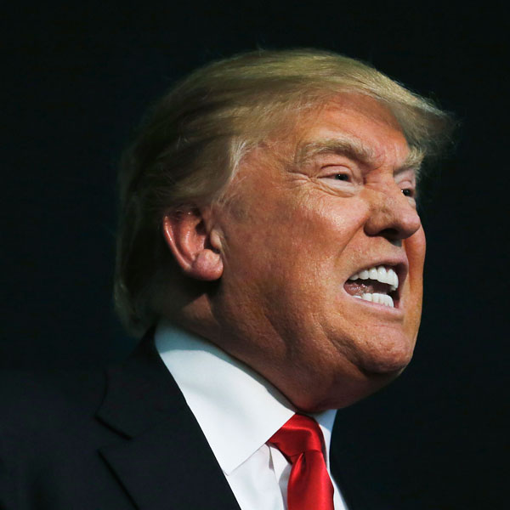
Union memberships are divided in many ways so you want your members (and non-members in an open shop) to understand that, as democratic processes are observed, the majority rules. It does not build our union if they go back in the workplace and complain that they were cheated or go off and sulk or try to wreck their union.

Slide 5
It is important not to mix up the principle and the procedure.
The members need to be able to vote on an issue, not tied up in a technicality.
Procedures should be clear and consistent, using both bylaws and guides like Robert’s Rules so members can debate the issue

Slide 6
Union
Constitution
Local Union Bylaws
Other laws
Parliamentary Procedure

Slide 7
Review your local bylaws
Notes, pp. 138-141
Guide, pp. 13-16
Who has what power?
Officers?
Executive Board?
Staff?
What decisions are subject to membership
votes—and when?
If a provision is included in the bylaw, it cannot be voted at a meeting.

Slide 8
Questions of spending the members’ money should be clearly covered in the bylaws
Salaries
Routine expenses
Special projects
Capital expenditures
Arbitrations
Travel
Lost time
Be careful of words like “reasonable” or “normal”

Slide 9
Does your local have committees under your Bylaws and what power do they have?
Are they standing committees (building, safety and health, compensation) or are they special committees, created to meet a unique situation?

Slide 10
Local Union Bylaws
When is the meeting held?
Where is the meeting held?
Should your local have shift meetings?
Who can attend the meeting?
Is there a quorum?
Who can vote on a motion?
Who can speak at the meeting?
What notice of the meeting is required?
How will votes be taken?
Is there a format for the meeting—an order of business?
Notes, pp. 138-141

Slide 11
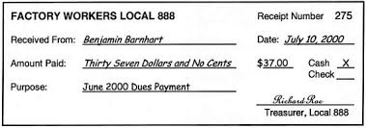
Are your membership records current and accurate?
How do members gain admission to a meeting, under the bylaws?
Do you allow absentee ballots on meeting issues?
Can retirees vote?
Laid off members?

Slide 12
How to have an Exciting Union Meeting
Preparation
Why are we meeting?
What do we want to accomplish?
What problem do we need to solve?
Who needs to be invited to participate?
Action agenda
Exchange information and discussion
Guest speakers
How will decisions be made?
Don’t waste the members’ time or they won’t come back.

Slide 13
Types of union meetings
Regular scheduled
Special called—maybe for a single issue like a contract vote or dues increase
Executive Board
Shop meeting—”informal meeting”
District meeting
International convention
Parliamentary procedure may be different for each meeting

Slide 14
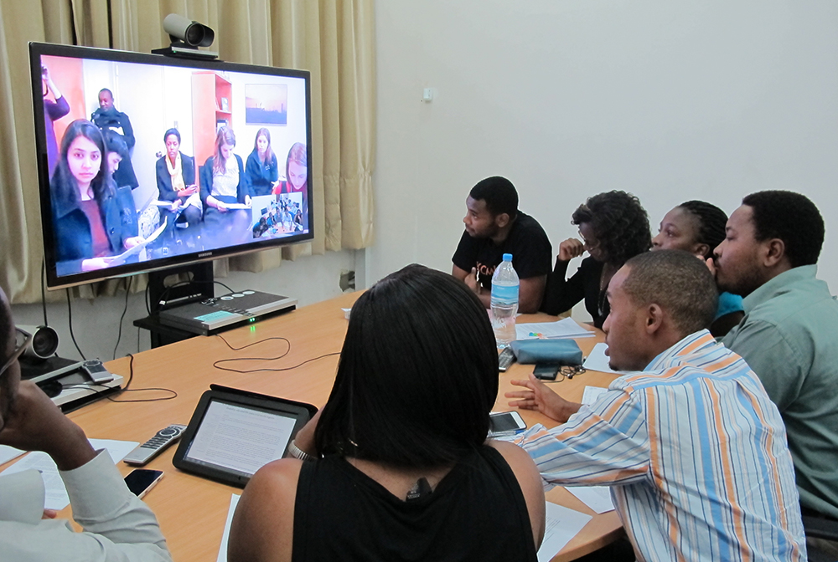
With new technology, and
larger local unions, do all meetings have
to be conducted in person?
What about conference calls?
What about webinar meetings?
What about parliamentary procedure?

Slide 15
Is there a format for the meeting?
Agenda
Attendance and Minutes
Reports
Old Business
Business from a previous meeting
New Business
Good and welfare
What business, if any, can be conducted in the absence of a quorum?

Slide 16
What authority does the chairperson have?
(Notes, pp. 142-146)
To preside?
To rule on a quorum?
To vote?
To speak on motions?
To rule on procedural questions?
To determine the order of business?
To limit debate?
To limit debaters by refusing to call on a member?
To make sure all motions are clear?
To determine voting procedures?
To suspend rules?

Slide 17
How does a member appeal a ruling by the chair? Notes, pp. 73-75
In this case, the chair can speak and can vote.
It is important not to mix up the principle and the procedure so clearly define the issue and vote on the issue.

Slide 18
Making a motion (Notes, pp. 16-34 Guide, pp. 17-68)
Clearly stated
Not in violation of local bylaws (if advance notice is needed, for example)
Seconded
Amended? Friendly or not.
Divided? (Notes, pp. 83-85)
Discussed
Voted—up or down—by what count
What voting method?

Slide 19
A motion to commit or refer (Notes pp. 35-44)
After a motion is made, a member can move that the issue be referred to a committee, either a standing committee or a special committee.
A motion to postpone (Notes, pp. 45-49)
Often mistaken as a way to avoid a vote, this motion allows more information to be gathered.
A motion to close, limit or extend debate (Notes, pp. 50-63) can be controversial so be careful

Slide 20
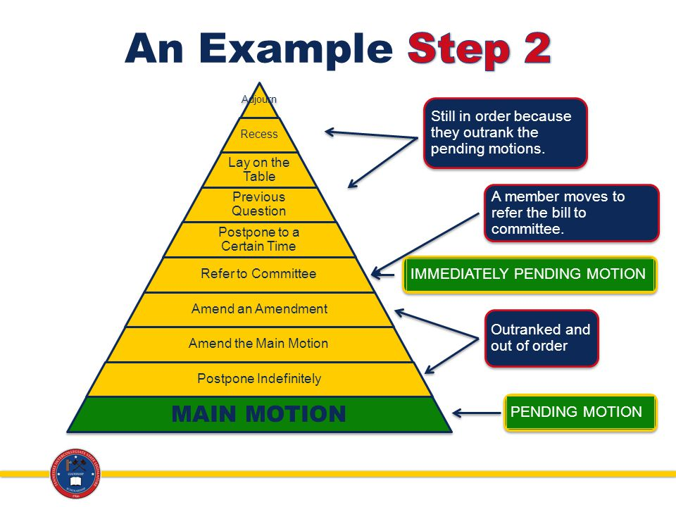

Slide 21

Taking accurate minutes is very important if a member wants to
challenge the results of the vote.
The bylaws should specifically state
Who takes the minutes
How the minutes are preserved
How the minutes are circulated to the members
Notes, pp. 121-123

Slide 22
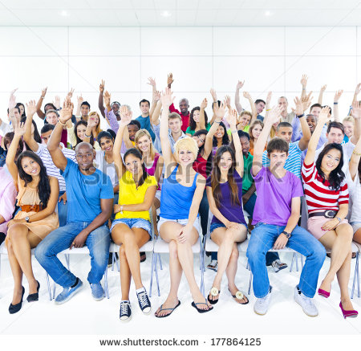
How is a vote taken? And who decides?
Notes, pp. 125-133
Voice vote?
Show of hands?
Divide the room?
Written ballot?
Do your bylaws require advance notice for certain votes?
If so, how is the notice delivered:
By mail
By e-mail
By posting at work
And remember—a tie vote means the motion does NOT pass
How does a member challenge the results of a vote? The procedure of a vote?

Slide 23
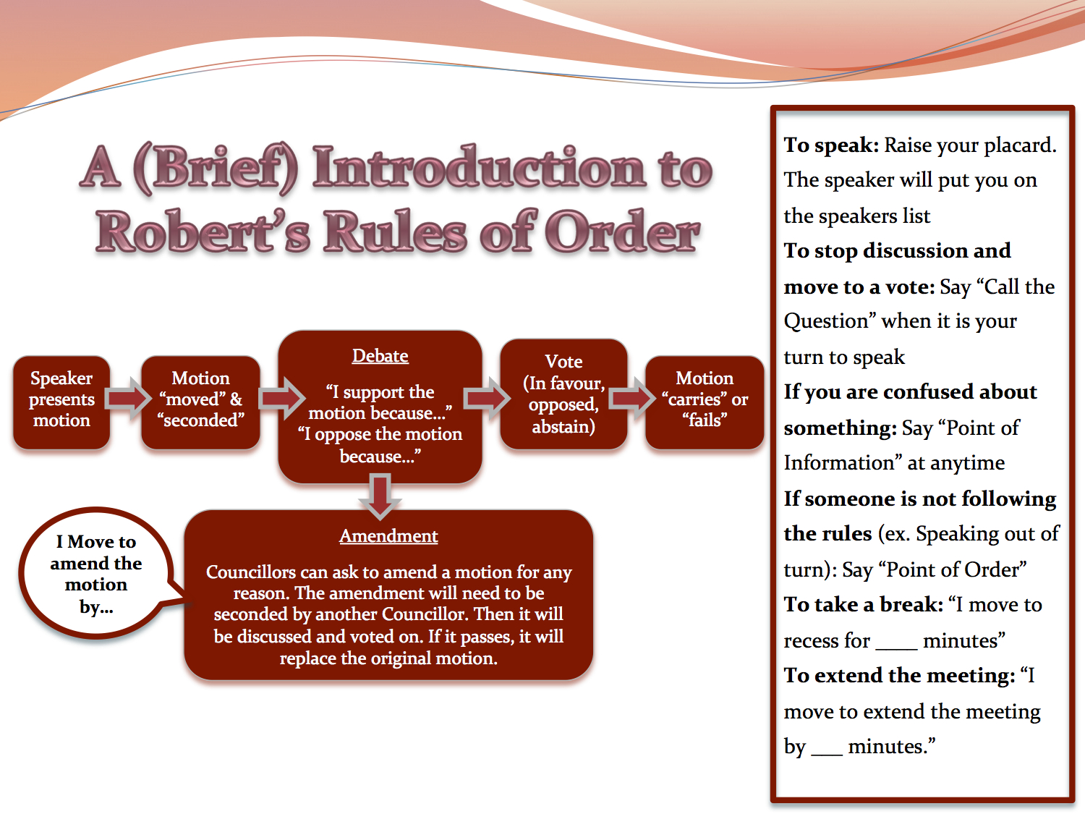
Is there any parliamentary authority in your local bylaws?

Slide 24

Does your union have, or require, a parliamentarian?
Notes, pp. 147-156

Slide 25
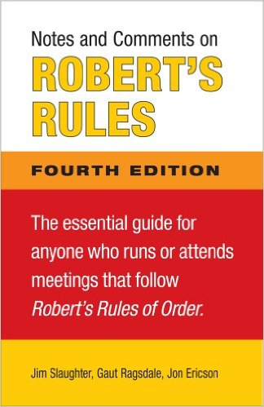
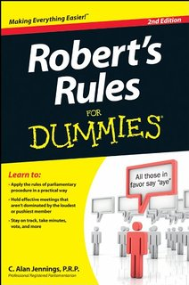
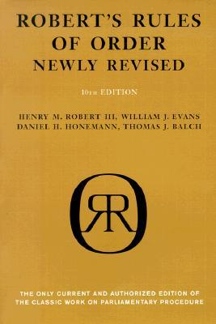
For more information on parliamentary procedure, check out
http://slideplayer.com/slide/717448/

Slide 26
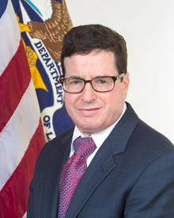

The Office of Labor-Management Standards, a division of the federal Department of Labor, enforces important procedures so you should look at their information
Andrew Auerbach-Acting Director OLMS
http://www.dol.gov/olms/
https://www.dol.gov/olms/union_info.htm

Slide 27
The Office of Labor-Management Standards (OLMS) in the U.S. Department of Labor is the Federal agency responsible for administering and enforcing most provisions of the Labor-Management Reporting and Disclosure Act of 1959, as amended (LMRDA).
  A "Bill of Rights" for union members;
  Requirements for reporting and disclosure of financial information and administrative practices by labor unions;
  Requirements for reporting and disclosure by employers, labor relations consultants, union officers and employees, and surety companies, when they engage in certain activities;
  Rules for establishing and maintaining trusteeships;
  Standards for conducting fair elections of union officers; and,
  Safeguards for protecting union funds and assets.

Slide 28
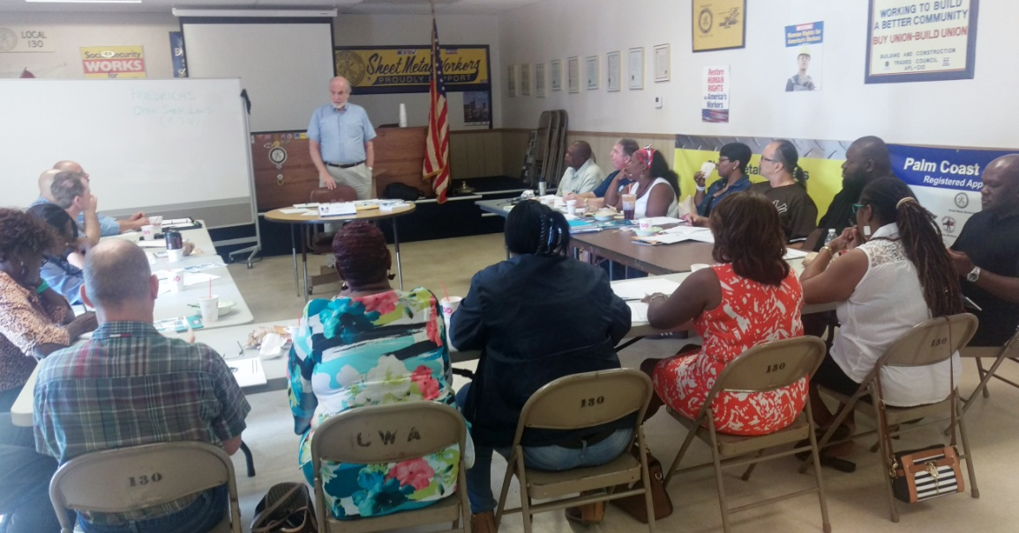
The ATU International offers training, as does OLMS in in response to requests by unions. OLMS offices all over the country receive such requests, and when that happens, the OLMS field managers usually extend invitations to all union officers within a reasonable distance of the geographic location of the training class. For topics of widespread interest to union officers and staff, OLMS has also offered webinars that can be attended remotely, and at which remote attendees can ask questions.
Any local interested in any particular topics (e.g. conducting officer elections, financial best practices, financial recordkeeping) should contact the DOL field office in your area.
In a unique offering of special interest to ATU members, OLMS provides Transit Employee Protections (13c) information
OLMS: (202) 693-0123 | TTY: 1-877-889-5627

Slide 29
There are some great videos on-line about Parliamentary Procedure
University of Missouri (15:00)
https://www.youtube.com/watch?v=lTG77brq2BY
Parliamentary procedure basics (15:43) from the 4H Club
https://www.youtube.com/watch?v=FfnBGolKmbM
How to Be an Effective Chair (What to say when...) (7:53)
https://www.youtube.com/watch?v=uvLDlPlxaRg
How to Start a Meeting - Effective Meetings (8:20)
https://www.youtube.com/watch?v=KCpcqdggF-0
How to Lead Meetings That People Enjoy Attending (7:19)
https://www.youtube.com/watch?v=b1QWPTYTCyo
How NOT to Run a Meeting (3:06)
https://www.youtube.com/watch?v=dyB-HBEvzOE

Slide 30
Laying the Groundwork for a Union Motion (2:14)
https://www.youtube.com/watch?v=b4WMAGhbxGk
Making and Debating a Motion at a Union Meeting
https://www.youtube.com/watch?v=OrZfniuFQJY (5:01)
Thanks to
Adriane Paavo
Education & Equality Department Leader | Chef de service éducation et égalité
United Steelworkers | Métallos
800-234 Eglinton Avenue East
Toronto ON M4P 1K7

Slide 31


