Slide 1
Explaining the Proper Role of Government in Our Everyday Lives
&
Doing It in Ways that Win Hearts and Minds
John Kretzschmar
William Brennan Institute for Labor Studies
University of Nebraska at Omaha
Notes:
Thanks for the opportunity to address this group, as we prepare to visit with our elected officials tomorrow.
Let me start with saying, I am not the smartest or best read person in the room. Whatever I have to offer that proves useful comes from 37 years of thinking, writing, and teaching about the role of labor unions and how to make them stronger.
This presentation is a variation on what I teach in the much longer “how to effectively talk union” class.
We have our 1 day promoting the General Welfare conference coming up on Saturday, March 11. The flyers are in your folders.

Slide 2
Reality Check
Nebraska is the 9th most conservative state in the nation using the metric the % of the electorate who voted for President Trump!
Here’s a breakdown of the number of registered voters in the state as of December 2016:
  Registered Republicans 584,173
  Registered Democratic 370,091
  Registered Independents 247,340
  Registered Libertarians 11,361
Our job is to win hearts and minds of the electorate regardless of political affiliation.
Notes:
In conservative Nebraska, the need to present a message that “persuadables” from all political parties can “hear” is an essential skill.

Slide 3
“In talking to people, don’t begin by discussing the things on which you differ. Begin by emphasizing—and keep on emphasizing—the things on which you agree. Keep on emphasizing, if possible, that you are both striving for the same end and that your only difference is one of method and not of purpose.”
“All levels of government, in our democratic republic, have a moral obligation to use our commonwealth in ways that protect and empower ALL of us EQUALLY.”
Notes:
We need to win hearts and minds rather than discussions or debates.
That calls for a different skill set than we normally practice in meeting with those not on the “union” bandwagon.
The first quote is from Dale Carnegie. In my experience, it is an important observation.
The second quote is one that, in my experience, works well in Nebraska.
We’ll talk some more about it later in the presentation.

Slide 4
Ever Had This Discussion?
You new neighbor is in the back yard and you come over to say, “hi, and welcome to the neighborhood.” You mention that you are a union member.
Your neighbor replies that, in his opinion, unions were once needed, but no longer are. And that he really resents that unions are so involved in politics.
How do you respond?
Notes:
Everyone in this room is, by definition, a difference maker…a change agent if you will. I want you to be the most effective change agent possible.
It’s inevitable that we will have discussions about labor unions and politics with our members, family, friends and acquaintances.
It is probable that you and those you talk to are on different pages when it comes to talking unions and politics.
You may have experienced this scenario or something similar in the past.
Raise your hand if this is familiar territory!
WHAT ARE SOME OF THE WAYS YOU HAVE RESPONDED TO SIMILAR SCENARIOS IN THE PAST?

Slide 5
What Does Government Exist to Do?
As we learned in elementary school, government exists to do for the citizenry that which they cannot do for themselves…or do well for themselves.
Governmental activities that fall in this category include: criminal and civilian court systems; infrastructure; regulation of the stock market and banking systems; police, fire, and armed services; public education; copyright and patent protection of intellectual property; unemployment and workers’ compensation insurance; pure food and drug laws; regulation of child labor; establishment of civil and voting rights; and more.
Notes:
People caught up in the “TOO BIG” frame for government, typically fail to think about the role that government plays in making our society work.
This slide is meant to establish that there is an important role for government to play. It is like a baseline reading on the things we sometimes forget.

Slide 6
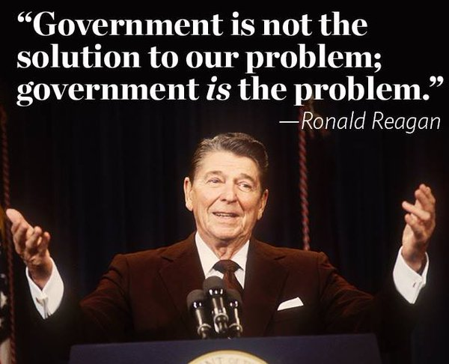
Origin of the “Too big/Too small” Frame
Notes:
This quote is from President Reagan’s first inaugural address. It has been taken as an article of faith by conservatives ever since.
In any message frame, the framer will intentionally include ONLY the information they want the audience to hear. That means they will intentionally exclude any information they don’t think is helpful to making their point.
This frame intentionally ignores all that government does on a daily basis to keep our society functioning. None of the stuff on the earlier slide is here. Reagan wanted his listeners/readers/viewers to only focus on government as a stumbling block…

Slide 7
What is the Best Way to Respond to the
“Too Big/Too Small” Frame?
So, you are talking with your neighbor about unions and politics. Your neighbor echoes the government is too big, too intrusive, and too expensive arguments that have been around since Ronald Reagan.
What are the ways that you would respond to such a “message frame” about BIG GOVERNMENT?
Notes:
Often we encounter message frames that are harmful to a full and fair discussion of the role of government in our everyday lives.
It is important to understand that in these situations, we are playing “defense.”
Too few of us understand what we need to do to maximize our chances of having our thought being heard.
The first lesson is to AVOID repeating the frame with which you don’t agree. Repetition even with a “NOT” in front of it, drives the frame you oppose deeper into the listener’s brain.
The second thing is to build a “values bridge” to the person(s) you are dialoguing.
The third is to start with the basics of why government exists…to do for us that which we cannot do ourselves or do well by ourselves.
You can give examples of things like mentioned in an earlier slide.

Slide 8
Build that “Values Bridge”
In discussing any issue with someone who has a differing world view than yours, it is ALWAYS an issue being heard and understood.
Why? Because a person’s version of common sense, i.e., their deeply held values act as a “filter” for all that you have to say.
That filter admits information that is consistent with their core beliefs, and rejects information that conflicts with their core beliefs.
All of this is being done 1) instantaneously and 2) below the level of human awareness.
Notes:
Archie Bunker, a TV character of decades ago, was a blue collar conservative in a family with more progressive values.
He disliked his son-in-law, whom he named “Meathead.”
When they would disagree over a matter of public policy, Meathead went straight to the facts to prove his point. He was NEVER successful in convincing Archie the first go around.
In fact, Archie would say “My mind is made up! Don’t confuse me with the facts.”
Archie’s mind acted as a filter. It screened out information that was inconsistent with his deeply held beliefs. That is how ALL our minds work.

Slide 9
Build that “Values Bridge”
We know that humans are capable of logical thought, therefore we use data, facts, information in an attempt to change minds.
Science reveals, that data, facts, and information are, by themselves, insufficient to the task. People only hear information that is consistent with their deeply-held beliefs.
So, to get yourself heard and understood you must create a “values bridge” to show that you and your audience share at least some common beliefs.
Once in place, the values bridge allows you data, facts, and information to be “heard.”
Notes:
It is interesting that when you and your audience share some beliefs, and as a result appreciate that you have something in common…there is an increased chance that you will be able to “hear” one another’s point of view.
In Nebraska, CornHusker fans can talk politics, may disagree, but still hear one another out.
Union sisters and brothers likewise can do the same thing.
But in each instance it’s ALWAYS a good idea to just review that the “values bridge” is in place.

Slide 10
The Values Bridge for
Discussing Government
Values bridges need to show “listeners” that they share a set of values with the “speaker.”
One of the most value laden stories that Americans have in their heads is the story surrounding our nation’s founding.
Tapping into that widely-held and deeply-felt set of values is a good bridge to use in discussing government and public policy.
It is something conservative commentators have been doing for decades, it’s time for union leaders to catch up.
Notes:
Tomorrow, you will be visiting with your State Senator. She/he needs to understand that you care about the state and the well-being of those who reside here.
I find it useful to start with creating a “values bridge” that relates to the story we are told about our nation’s founding.
Why? Because it is one of the earliest stories that ties morality to government. Tapping into it, shows you are wanting to live our founding values.
That puts you and your State Senator on the “same page” and let’s your particular point of view to be heard. Remember the Dale Carnegie quote from an earlier slide.
A side benefit is that you are providing a “message frame” that the state senator can use if they have to explain their vote to the “folks back home.”

Slide 11
Getting Beyond “Too big/Too small”
When discussing government, thanks to Ronald Reagan, most discussions of government revolve around the “too big/too small” frame.
In my experience that is a LARGE WASTE OF TIME!
The question becomes, how can we move from that old frame to a frame that is more useful in discussing and setting public policy?
Here’s the formula that I have used for several years that generally (but not always) creates a more useful dialogue.
Notes:
Never rebut a frame that you disagree with, by repeating that frame!
Neurons that fire together, wire together. The more often they fire together the deeper and stronger the connections become.
Repeating a negative frame, because of the way our minds work, merely deepens the negative frame in the heads of your audience.
We see this played out on Sunday morning news shows. We hear the moderator ask a clear question and the politico avoid the question and go back to prepared talking points.
While that behavior may drive you CRAZY, it is a way to drive a politico’s talking points deep into the brains of those watching.
Always reframe to rebut.

Slide 12
The Values Bridge for
Discussing Government
We all learned in school that the U.S. was the first democratic republic based on the idea that we are ALL created equal and ALL endowed with inalienable rights.
We learned that government exists to do for us that which we are incapable of doing for ourselves…or doing well for ourselves.
We learned our Constitution states that government exists to advance the common good and promote the general welfare of the ENTIRE nation.
Every time we pledge allegiance to this nation we repeat that ours is a nation with liberty and justice for ALL.
Notes:
Just some examples of statements that help build the values bridge when talking politics.

Slide 13
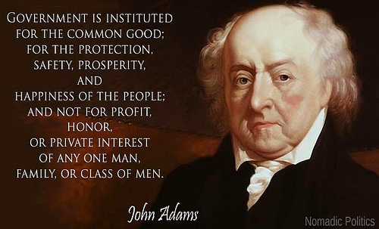
Government’s Purpose
Notes:
Quotes are useful tools for getting a message across. When you quote a “famous” American, you are doing two things.
First, you are saying, in essence, that you are NOT alone in your opinion.
And second, you are adding a level of importance to your point of view.

Slide 14
Building a More Useful Frame
Once the bridge is in place, use the following sentence…
“I believe it’s fair to say that all levels of government in our democratic republic have a moral obligation to use our commonwealth in ways that protect and empower ALL of us EQUALLY.”
This simple sentence does several important things.
First, it replaces the “too big/too small” frame with a discussion of what are the legitimate protection and empowerment functions of government?
  More on that later…
Notes:
All thought is physical.
Neurons that fire together, wire together.
The more often they fire, the deeper and stronger the connections become.
Message that are repeated often, become part of our consciousness.
The conservatives have repeated over the decades that their worldview with respect to government revolves around less taxes, fewer regulations, greater individual freedom and their version of family values.
This sentence reframes the role of government.
This sentence needs, IMO, to be repeated as part of a values bridge EVERY time you talk about the proper role of government in our everyday lives.

Slide 15
Building a More Useful Frame
Second, it turns the budgets of government institutions into “moral documents” that can be searched to see if there is sufficient resources available to insure that agency can efficiently and effectively carry out its protection or empowerment function.
When speaking of “commonwealth” or sufficient resources, you are talking about taxes as well as natural and human resources.
Notes:
When I use the word “moral,” I am meaning “right vs. wrong” rather than any particular moral credo.

Slide 16
Building a More Useful Frame
Finally, it can be used to counter the privatization or contracting out of government services. Here’s how.
Privatization and contracting out places the need to make a profit above the “moral mandates” of government.
It ends transparency, a hallmark of good government, because companies conduct their business behind closed doors.
It ends accountability, another hallmark of good government, because when a business changes direction to make more profit elsewhere, it leave government with no resources to pick up where it left off.

Slide 17
More on the Protection Function
Protection functions of government begins with the military, police, fire services; as well as the criminal and civil court systems.
It extends to the legitimate role of defending the citizenry from the excesses of an under-regulated market economy. This function includes protections for consumers, wage earners, pensioners, the environment, disaster relief, safeguarding the integrity of all forms of financial investment and more.
Notes:
When a greed-driven economy dedicated to the maximization of short term profits offers goods or services that endanger the public, government has a legitimate role to act as referee and protect the public.

Slide 18
More on the Empowerment Function
  Empowerment functions begin with the use of public resources on a large scale for commerce, human development, and civic improvement.
  Government achieves this by leveling the playing field, and removing barriers to the American Dream. Its responsibilities extend to public education, creation and maintenance of physical infrastructure, agricultural assistance, regulation of financial institutions, provisions for production and transmission of power, sponsored basic research, and more.
Notes:
Infrastructure includes (bridges, roads, public buildings, water and sewer systems);
“There is nobody in this country who got rich on his own — nobody. You built a factory out there? Good for you. But I want to be clear. You moved your goods to market on the roads the rest of us paid for. You hired workers the rest of us paid to educate. You were safe in your factory because of police-forces and fire-forces that the rest of us paid for. You didn’t have to worry that marauding bands would come and seize everything at your factory — and hire someone to protect against this — because of the work the rest of us did.
“There is nobody in this country who got rich on his own. Nobody. You build a factor out there – good for you!
But I want to be clear. You moved your goods to market on the roads the rest of us paid for. You hired workers the rest of us paid to educate. You were safe in your factory because of police forces and fire forces that the rest of us paid for. You didn’t have to worry that marauding bands would come and seize everything at your factory and hire someone to protect against this, because of the work the rest of us did. Now look, you built a factory and it turned into something terrific, or a great idea. God bless — keep a big hunk of it.
But part of the underlying social contract is, you take a hunk of that and pay forward for the next kid who comes along.” Elizabeth Warren, Harvard Law School professor and Democratic candidate for Senate in Massachusetts

Slide 19
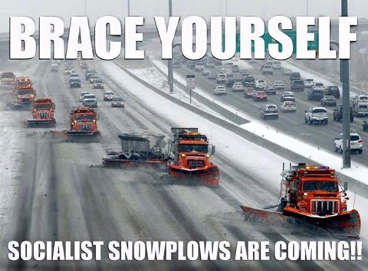
Notes:
This slide is meant to amuse us while pointing out an important contradiction.
Conservatives are continually worrying about “creeping socialism” when it comes to programs that help everyday wage earners.
They forget the purpose of government: to do for us that which we cannot do for ourselves…or to do well for ourselves.
Conservatives avoid labeling the military, police, and fire services this way. Likewise they fail to label our criminal and civil courts or regulation of the stock market and copyright and patent protections that way.
BTW, creating and properly maintaining an infrastructure is both a protection and empowerment function of good government.

Slide 20
Where Do Unions Fit?
Wrap them in the flag! Our founders 1) challenged the legal property rights of the English and 2) established a democratic nation that gave a voice to the formerly voiceless.
Employers in the private and public sector think 24/7 about finding ways to make their operations “leaner and meaner” often by finding ways for employees to “do more with less.”
So labor unions exist to introduce meaningful democracy to the workplace…often over employer objections…to give employees a voice in jointly determining their future quality of life.
Notes:
Again, unions fulfill both a protection and empowerment function of good government and therefore deserve governmental endorsements.
“But it has so happened in all ages of the world, that some have labored, and others have, without labor, enjoyed a large portion of their fruits. This is wrong and should not continue. To secure to each laborer the whole product of his labor, or as nearly as possible, is a most worthy object of any good government.” (1847) Illinois Congressman Abraham Lincoln, later to become 16th President of the United States

Slide 21
Where Do Unions Fit?
“Join the union, girls, and together say Equal Pay for Equal Work.” Susan B. Anthony in The Revolution 1869
In a nation dedicated to the idea that we’re all equal and have inalienable rights, unions level playing fields and remove barriers on the path to the American Dream.
Unions are the tools that everyday wage earners use to climb out of poverty and into the middle class.
Unions are arguably our nation’s oldest, largest, and most successful institution advocating for economic and social justice.
Notes:
Unions are as American as apple pie.
They help everyday wage earners establish meaningful workplace democracy.
Unions are the tools that give employees a voice in jointly with management determining their future quality of life.

Slide 22
What is the Proper Role of Government in our Every Day Lives?
“All levels of government, in our democratic republic, have a moral obligation to use our commonwealth in ways that protect and empower ALL of us EQUALLY.”
Notes:
Nebraska is a conservative state. We need to learn to converse with conservatives about the PROPER role of government in our everyday lives. These interactions happen ALL the time.
Our job is to find ways to get our worldview about government heard and understood by those who are not on the “union train.”
This statement is capable of reframing the “too big/too small” to what are the legitimate protection and empowerment functions of government?
It turns every institutional budget into a MORAL document that can be examined to see if the resources are there to efficiently and effectively carry out its protection or empowerment functions.
The more often you use this message frame, the deeper it is dug into the minds of those you with whom you are communicating.

