Slide 1


Slide 2

Welcome!
Please join a table and read the scenario.
Introduce yourselves and work with others at your table to discuss the questions on Worksheet #1.
Notes:
At 7:40: Do a quick demographic poll, everyone here from Council 2, Washington State, stand up, HGEA, Hawaii, UPW Hawaii, Alaska, AMEA, Alaska PSEA, Alaska ASEA, Montana Council 9.
Welcome group, Joe & I introduce ourselves.

Slide 3
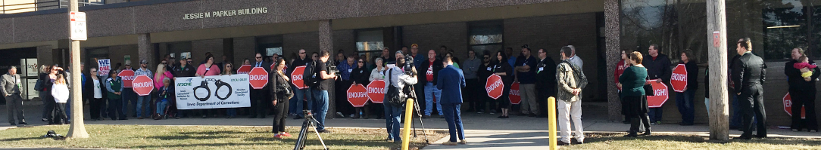
AFSCME in Action Goals
Knowledge and skills to plan and execute a march on the boss.
Commitment to use new tactics to win on issues that matter to workers.
Motivation to use workplace actions to win on issues back home.
Notes:
Review goals: Here’s what we’re going to do this morning…

Slide 4
Agenda
Table Discussions and Report Out
Simulation
Debrief
Notes:
Here’s our plan for this morning. We need to get you out by 9:30 so we’ll be keeping careful track of time. Our time together will give you a chance to learn from each other, bring your experience and creative ideas to the table, have some fun and get inspiration to take home with you.

Slide 5
Ground Rules
Listen and speak with respect for each other
Keep an open mind
Step up and step back
Leave your title at the door
Electronic devices silent
Take a break if you need to
Stay on schedule
Notes:
So we can have quality time, here are our proposed ground rules – read and clarify those that may not be clear.

Slide 6
Principles of Direct Action Organizing
Win real immediate improvements in peoples’ lives.
Give people a sense of their own power.
Alter the relations of power.
Notes:
We are going to experiment with using direction action organizing to deal with a workplace problem.
Read and give an IL example?
Let’s start by discussing the questions on Worksheet 1 – Opening Table Discussion. [Do NOT get responses from every table but try to make sure each table has a chance to respond to at least one question.]
What is the issue
Do people seem to care about this issue? Why?
Is this issue likely to unite or divide workers? Why?

Slide 7
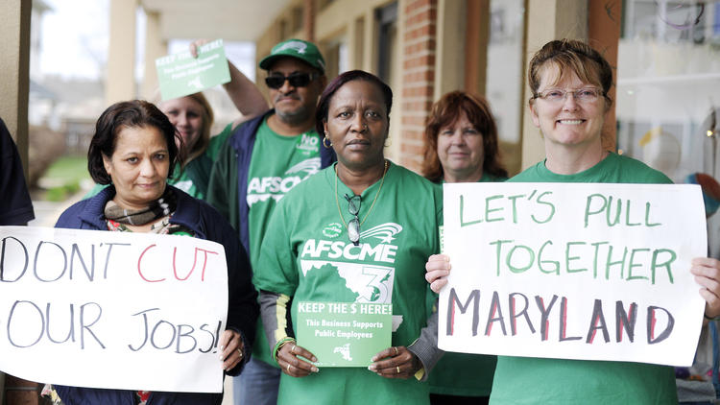
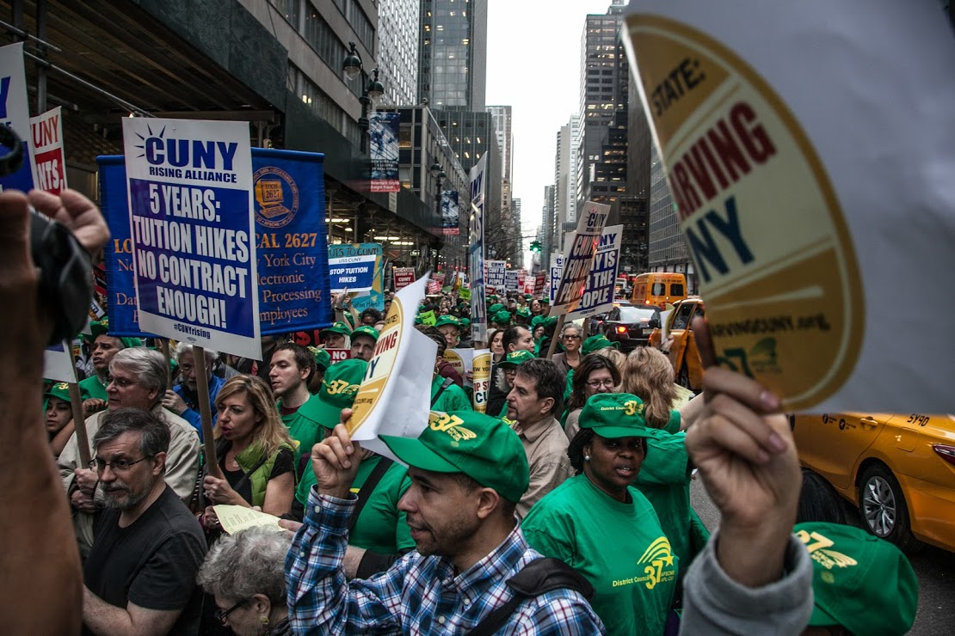
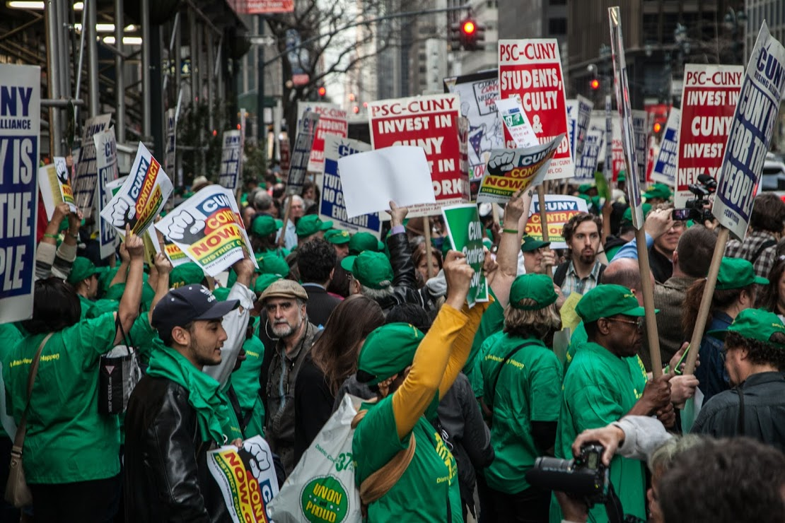
Direct action organizing…
…gives everyone an opportunity to be an active part of our union
…builds membership power
…enhances communication with the membership
…develops new leaders and members
…is often faster and more likely to succeed
Notes:
Read and give an IL example?
Let’s start by discussing the questions on Worksheet 1 – Opening Table Discussion. [Do NOT get responses from every table but try to make sure each table has a chance to respond to at least one question.]
What is the issue?
Do people seem to care about this issue? Why?
Is this issue likely to unite or divide workers? Why?

Slide 8
Checklist for Choosing Issues
 | 1. Is it WIDELY FELT?
 | 2. Is it DEEPLY FELT?
 | 3. Is the issue EASILY UNDERSTOOD?
 | 4. Is the issue NON-DIVISIVE?
 | 5. Is the issue WINNABLE?
 | 6. Is the solution CLEAR AND EASILY UNDERSTOOD?
 | 7. Is the issue WORTHWHILE?
Notes:
In order for direct action organizing to work, it’s very important to start with a workplace issue that is suitable for organizing our co-workers to take action.
BUT, not all workplace problems are good ones to engage and activate others. Here are some criteria – also available on the Convention website for download.
What remedy should our union pursue? (shout outs) Is it a reasonable remedy? (page 6 of guide for more talking points)
What advice would you give to a local union leadership team about winning on this issue?
Changing hats, what advice would you give a management team?
What we’re going to do now is simulate what it would look like for both management and the local union to have a march on the boss.

Slide 9

Notes:
Deb debrief: Did this action build power for our union? How and why? (Teaching points page 10)
What was the the union’s strategy? How did the tactic, march on the boss, move the strategy forward? [Discuss meaning of target and how tactics and strategies work with different targets. Page 11]
Joe debrief: What was management’s strategy? [page 11 teaching points]
Turnout – What roles dos turnout play in a successful action?
Message – What was our union’s message? How might it have been received by different audiences? [page 12]
Deb: Documenting – Ask the doc group if they have any comments about how things looked from their perspective. Why is it important that we document the action? What do we do with the documentation? [page 13]
Next Steps/Escalation: Report out their plan if we don’t win following this action.
Joe: How to Apply this at Home [page 14]

Slide 10

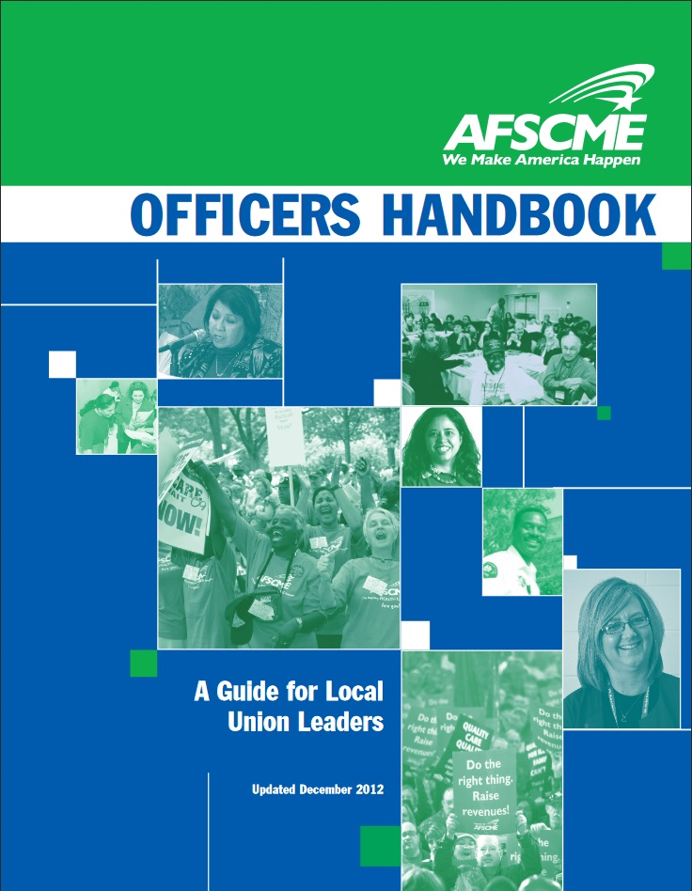
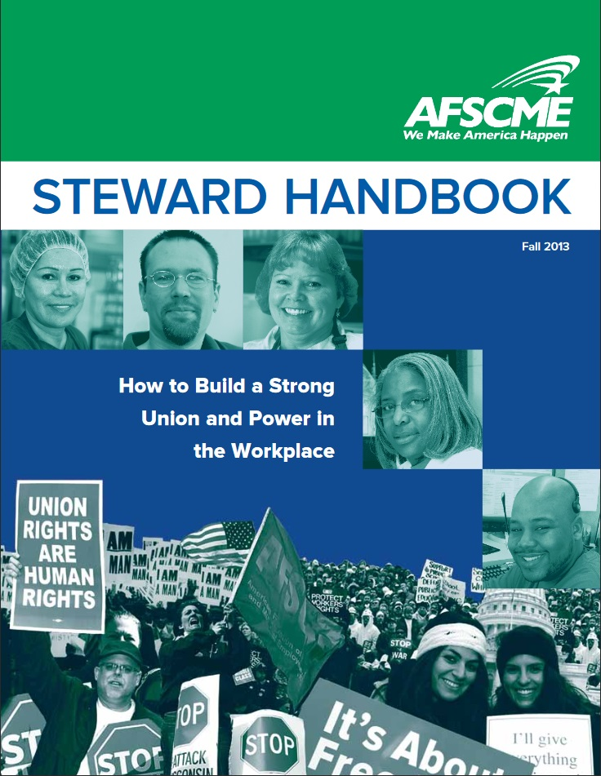
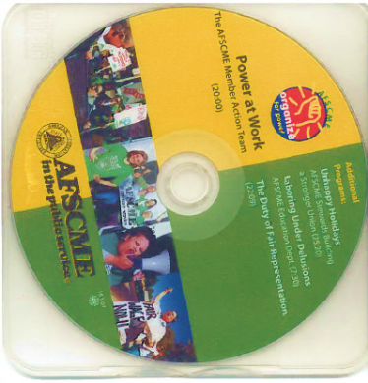

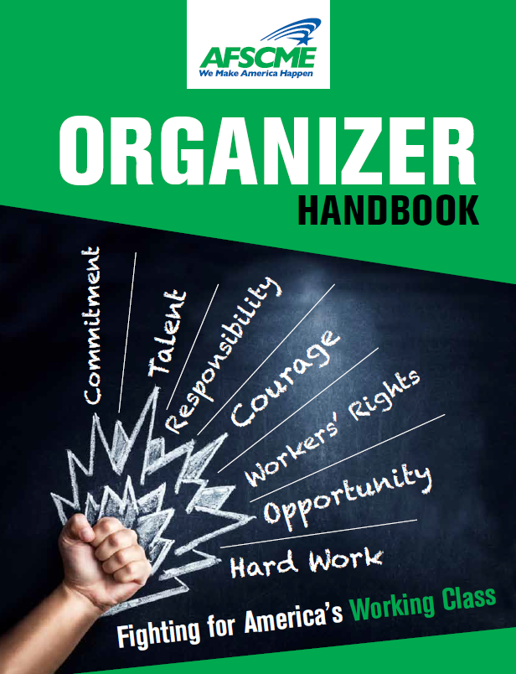

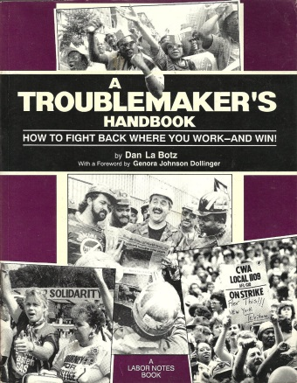
Resources
Notes:
Here are some Resources you can look up. The AFSCME Handbooks are online at afscme.org
We want to hear about direction actions you do when you are back home. You will see highlights from our documentation teams in a slide show later this week.

Slide 11
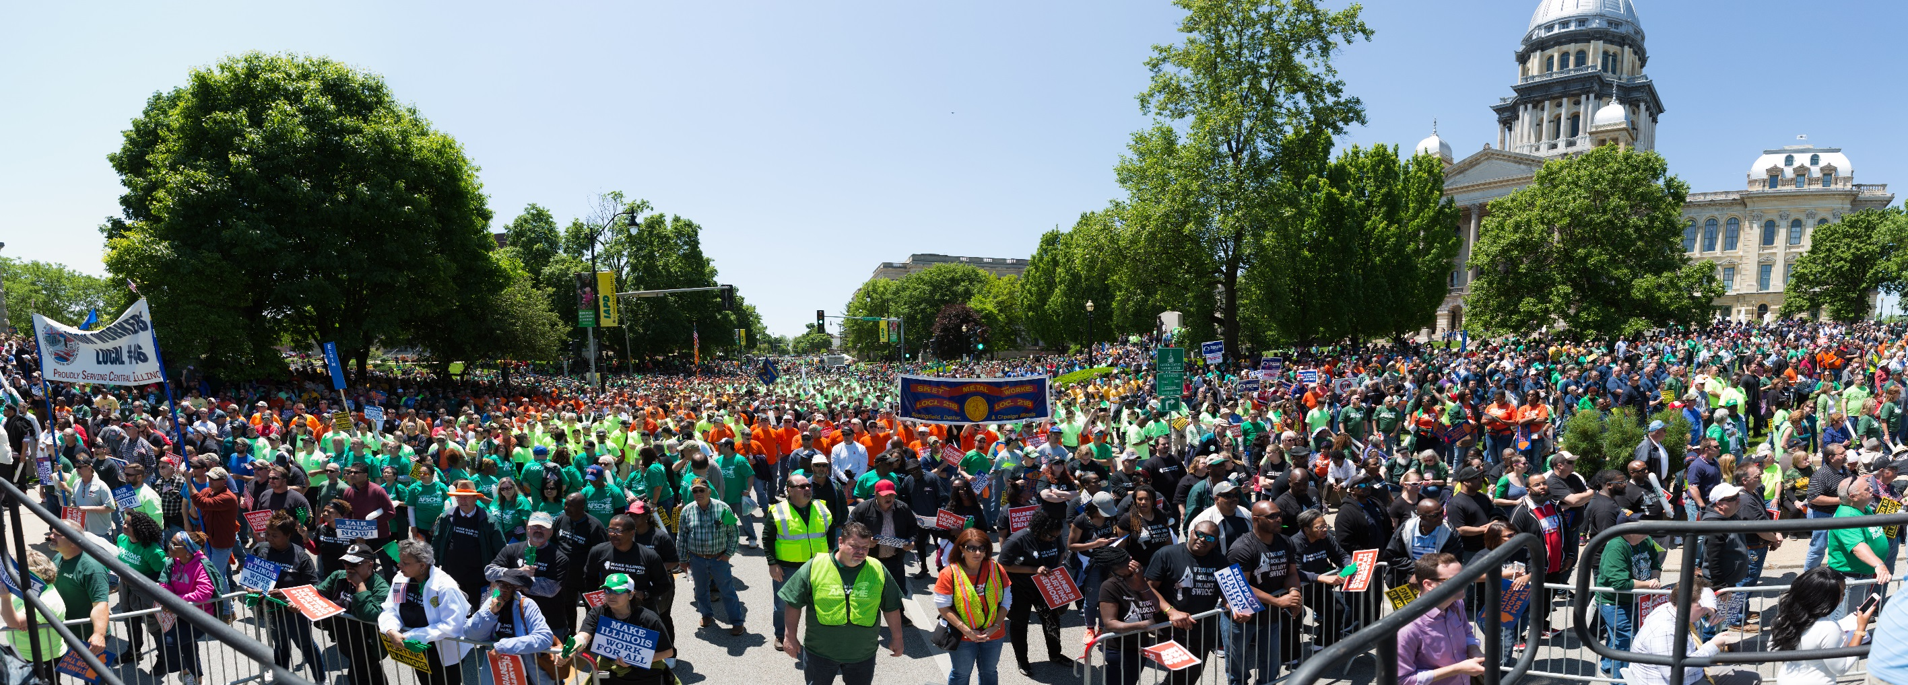
Notes:
We will also have a chance to take direct action this afternoon marching on the Trump Towers. Thank you all. See you on the streets!
[Documentation team needs to choose their top photos, 10 at most, and email them to sally@afscme.org]

