Slide 1

LABOR EDUCATION AND GLOBAL SOLIDARITY
IFWEA
IVA
FIAET
BUILDING A GLOBAL KNOWLEDGE COMMUNITY: RE-CALIBRATING WORKERS’ EDUCATION FOR THE 21ST CENTURY
Sahra Ryklief
UALE Plenary input on Labor Education and Global Solidarity
6 April 2017

Slide 2
What and who is IFWEA?
IFWEA
IVA
FIAET
Global Federation of Worker Educators
Governed by its affiliates
Unique status within the International Labour Movement

Slide 3
What motivates us?
IFWEA
IVA
FIAET
Building a conscious, organised and diverse global labour movement
Values based education
Respond to changes to the Labour Market
Survivalist economic activity and deregulation
Decline of class and communal solidarity

Slide 4
What do we do?
IFWEA
IVA
FIAET
Knowledge Provision
Conforms to their current reality
Development of a new narrative
Building of co-alitions and relationships

Slide 5
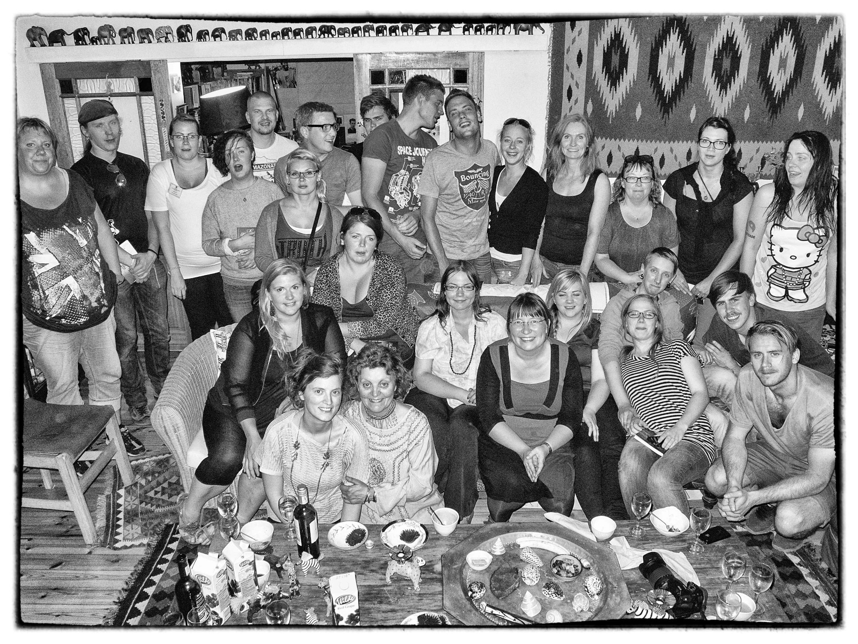
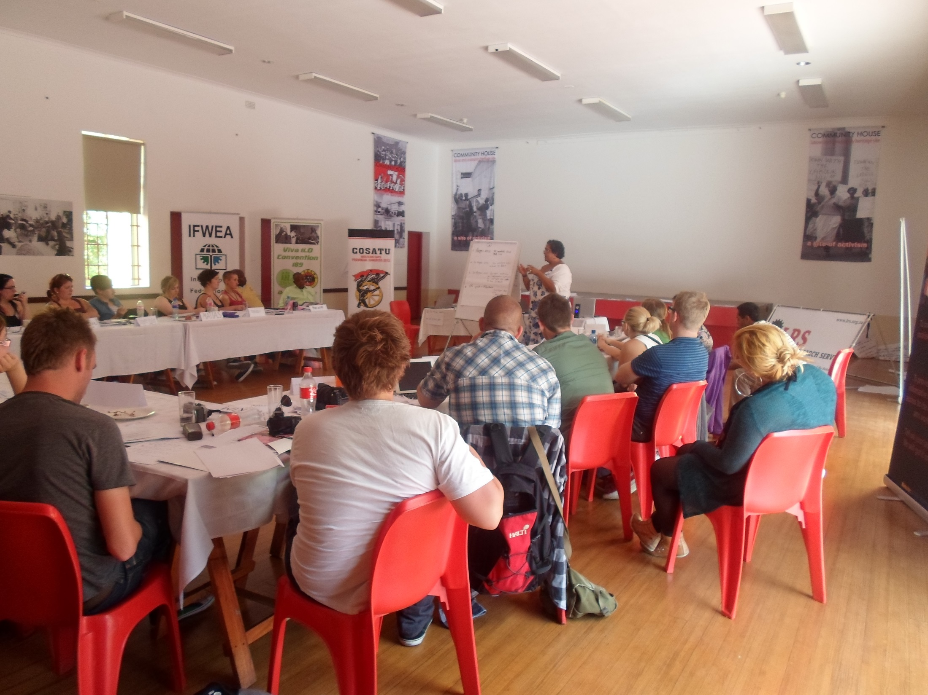
IFWEA
IVA
FIAET

Slide 6
THE GLOBAL CONTEXT:
YGAP - The Youth Globalisation Awareness Programme of the International Federation of Workers’ Education Organisations.
IFWEA
IVA
FIAET
Young worker educators, trade union and youth leaders
Principles, learning objectives, curriculum and review process
Building a global knowledge community of young internationalists

Slide 7
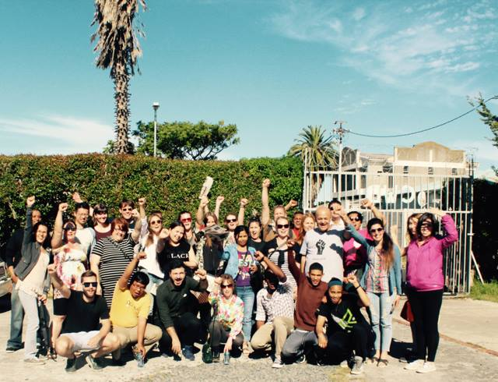
IFWEA
IVA
FIAET

Slide 8
Foundation Skills for Social Change Certificate Programme
IFWEA
IVA
FIAET
Online Courses to build the capacity of grassroots leaders in trade unions and community organisations
2017 topics:
Women’s leadership
youth civic and political mobilisation
participatory learning and research methods
organising for the social protection of vulnerable workers

Slide 9
IFWEA
IVA
FIAET
Designed by IFWEA affiliates
Accessible and user-friendly
Provide course participants with theoretical and analytical skills to enhance their educational, organising and mobilising role as grassroots leaders
Accessed online and certificates are issued by the IFWEA Secretariat on completion of the course indicating that the participant has accomplished the learning objectives of the selected course and that, in the process, has Contributed to the global knowledge community through their course activities.
Further courses will be added on an annual basis to this programme.

Slide 10
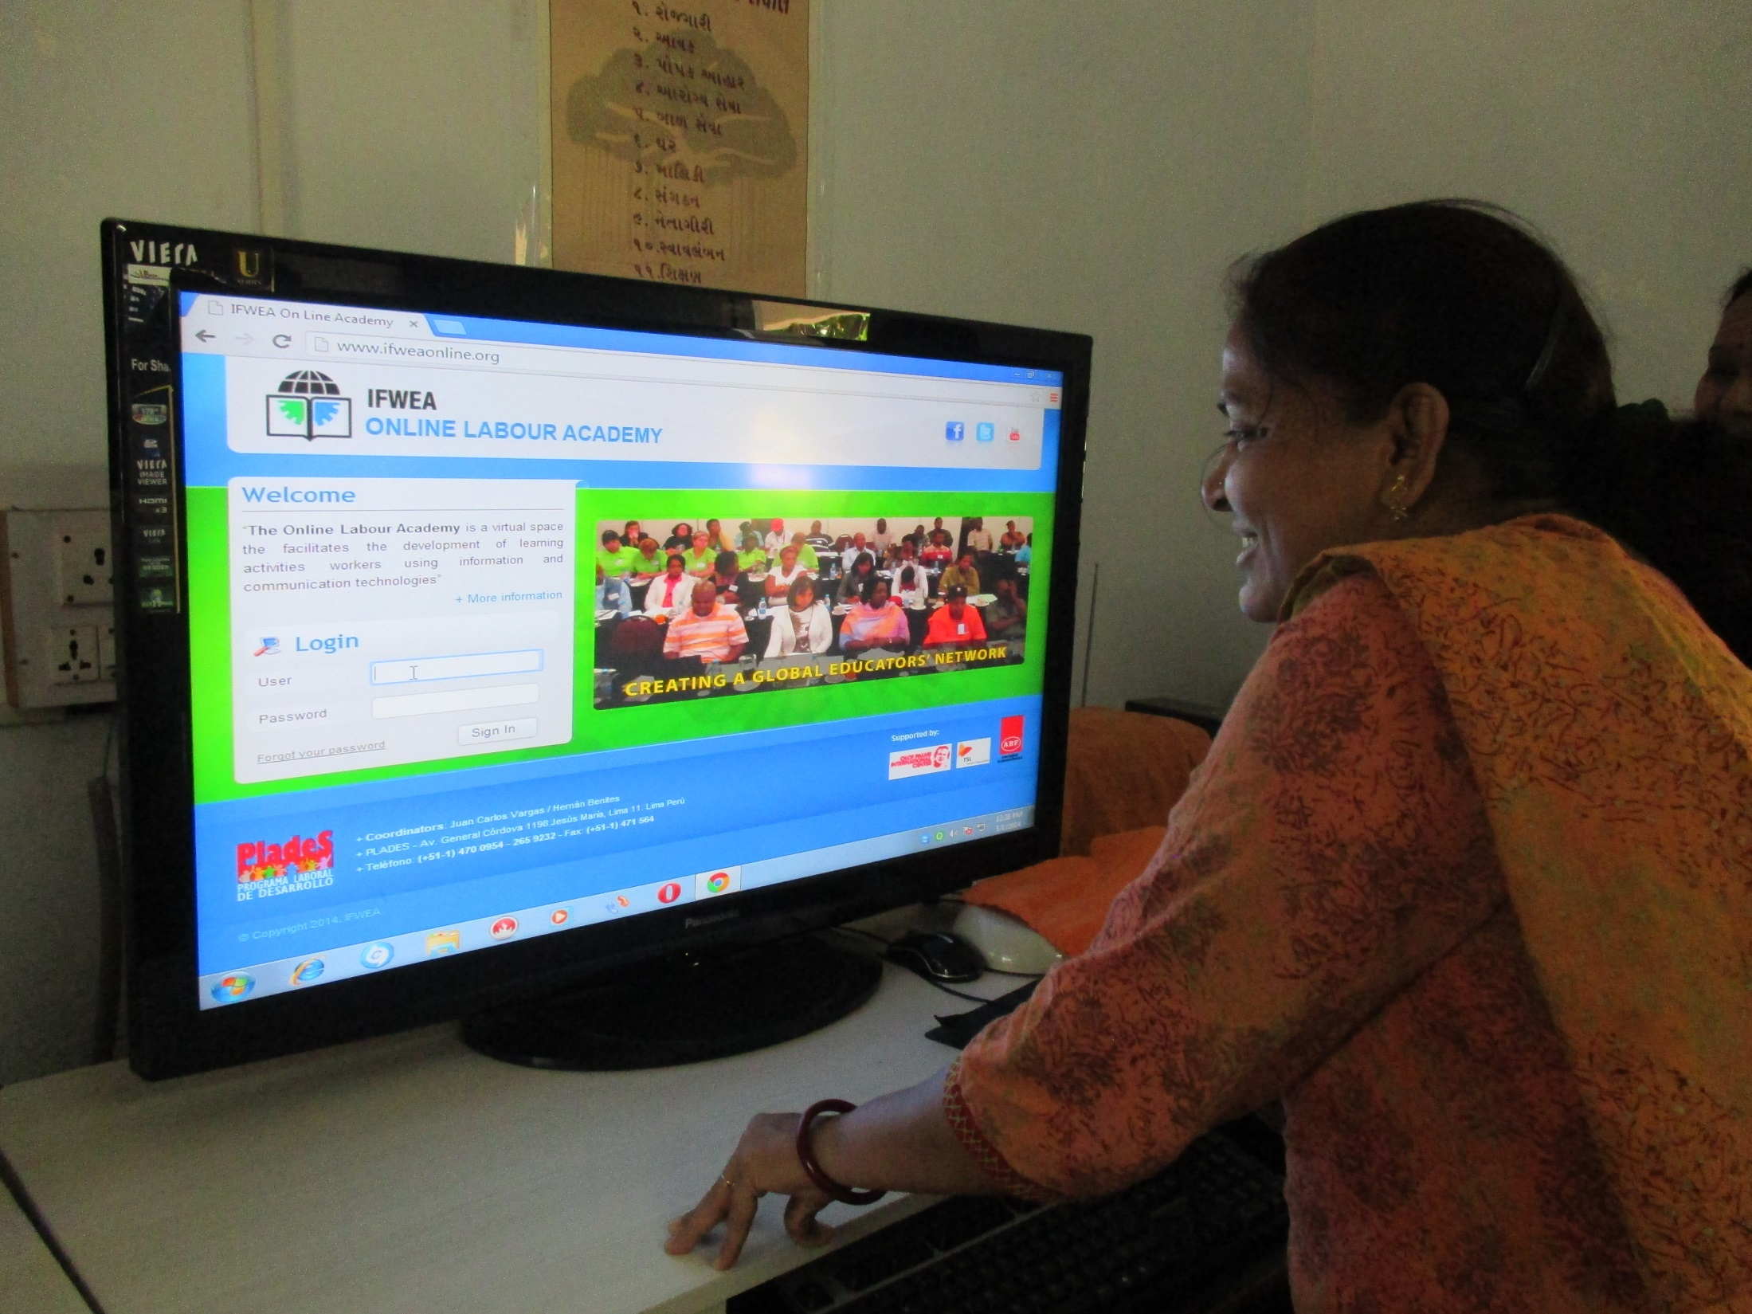
IFWEA
IVA
FIAET

Slide 11
FSSC’s Online Workers’ Education Learnership
IFWEA
IVA
FIAET
Develop young educators in the labour movement
International dialogue on curriculum design, pedagogy and materials
Learnership provides young worker educators with the skills to design and introduce study circles and online education courses aimed at promoting the interests of young workers in trade unions and community organisations. The course outline is available on the IFWEA Online Labour Academy (www.ifweaonline.org)

Slide 12
Making Your Mark: IFWEA’s global project for advancing democratic political engagement of young, grassroots leaders
IFWEA
IVA
FIAET
Youth Human Rights Ambassadors: “Limerick Be Heard”: Supported by a collaboration of Limerick Youth Services and IFWEA affiliate ENGAGE at the University of Limerick.
Youth Human Rights Ambassadors: “Cape Town Be Heard”:
Study circle leaders from community based associations.
Both groups design popular communication materials.
Including more partners in 2018 & 2019.
Research on the impact of this form of “engaged political education” will be conducted

Slide 13
IFWEA
IVA
FIAET
Targeting young people between the ages of 16 and 25
Make equality and human rights real for young people
Equip them to promote political participation for youth social justice and inclusion
The project captures the creativity and dynamism of young people as a strategic resource
They act as the drivers for social change, not as passengers.
Promote political participation and political agency for rights and inclusion.

Slide 14
THE LOCAL CONTEXT:
IFWEA’S Study Circles for Social Change: towards a South African Study Circles Association
IFWEA
IVA
FIAET
ABF: 100 years of experiences of popular education
Degeneration of trade union education
Formation of political identity and values
Creation of new spaces

Slide 15
IFWEA
IVA
FIAET
Developing and mentoring study circle facilitators
Build confidence, encourage critical thinking and promote active participation
Membership-based organisation
Inclusion of trade unionists
Online interaction between study circle facilitators

