Slide 1
CUPE Equality History Project
Notes:
After many hours of digging through old journals, hunting for photos and pulling together the stories, the union has published a web-based timeline of equality activism over the last 52 years.
The timeline lists more than 200 events that mark significant advances in equality – in our union, our workplaces, and our communities.
Advances that improve the lives of : women, LGBTTI, racialized and Aboriginal members and members with disabilities. They’re about bargaining, political action, organizing, education and all the ways we make change.
The stories extend internationally, over five decades of global solidarity work.
The full timeline is on the cupe web site. You can scroll through it online. In the next ten minutes, we’ll show you some highlights.

Slide 2
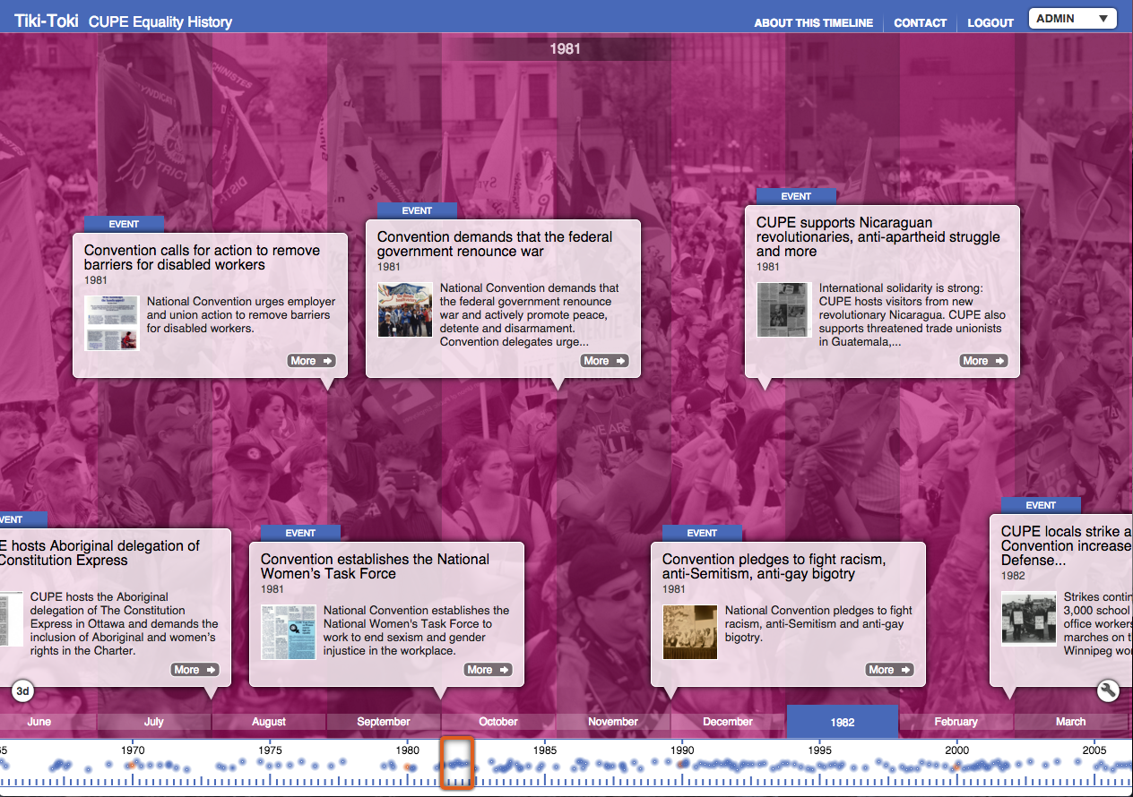
CUPE Equality Timeline
Notes:
The equality timeline is a digital display - on the cupe web site - of 216 events over 52 years. There is a one or two sentence summary of each event, often with photos, articles and video links.
http://cupe.ca/cupe-equality-history-digital-timeline

Slide 3
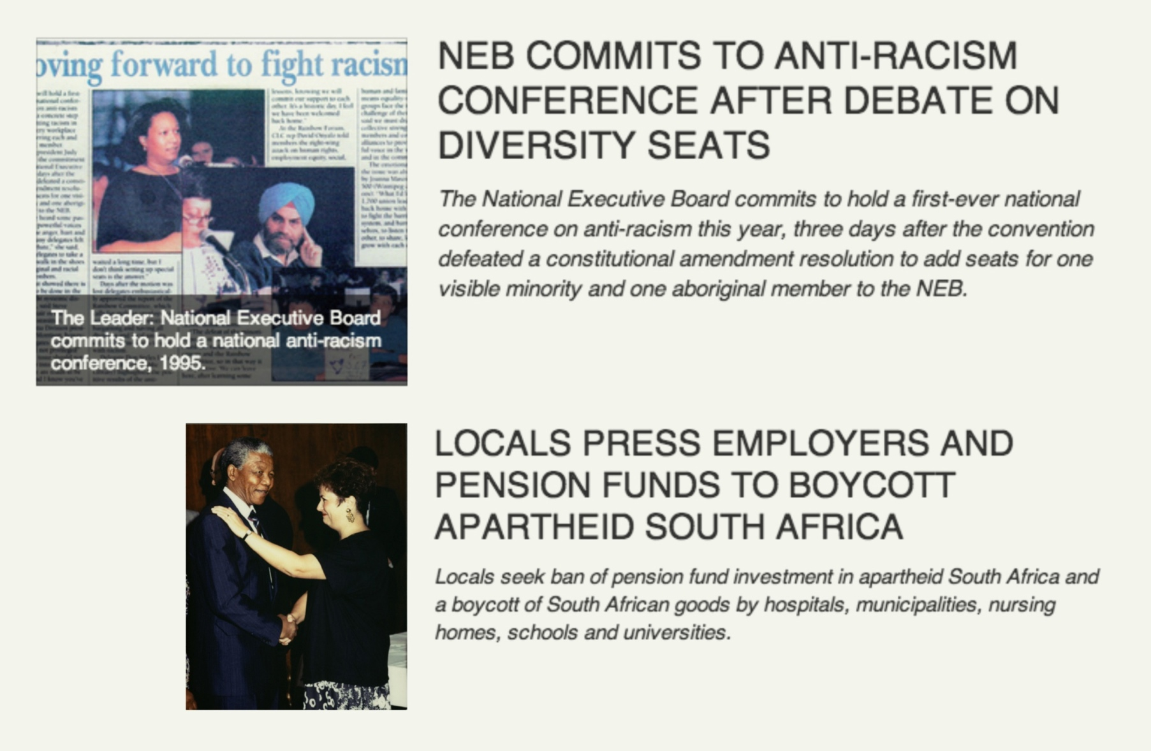
Notes:
Our history of action against racism spans decades and shows diverse strategies.
It includes fights for employment equity, representation in leadership, and solidarity at the international level.

Slide 4
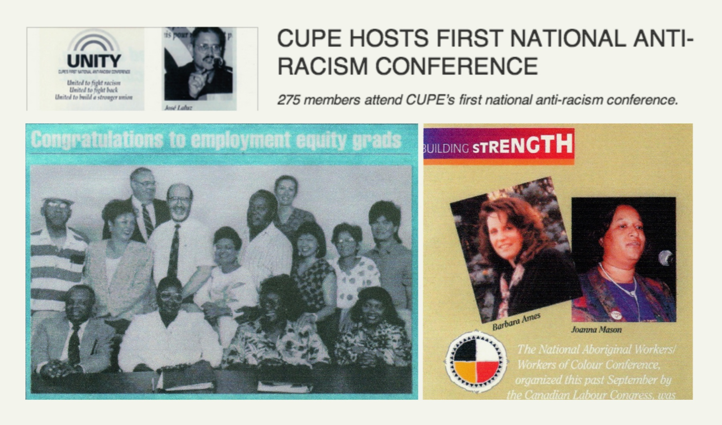
Notes:
Education and building our power – these are themes throughout the timeline.

Slide 5
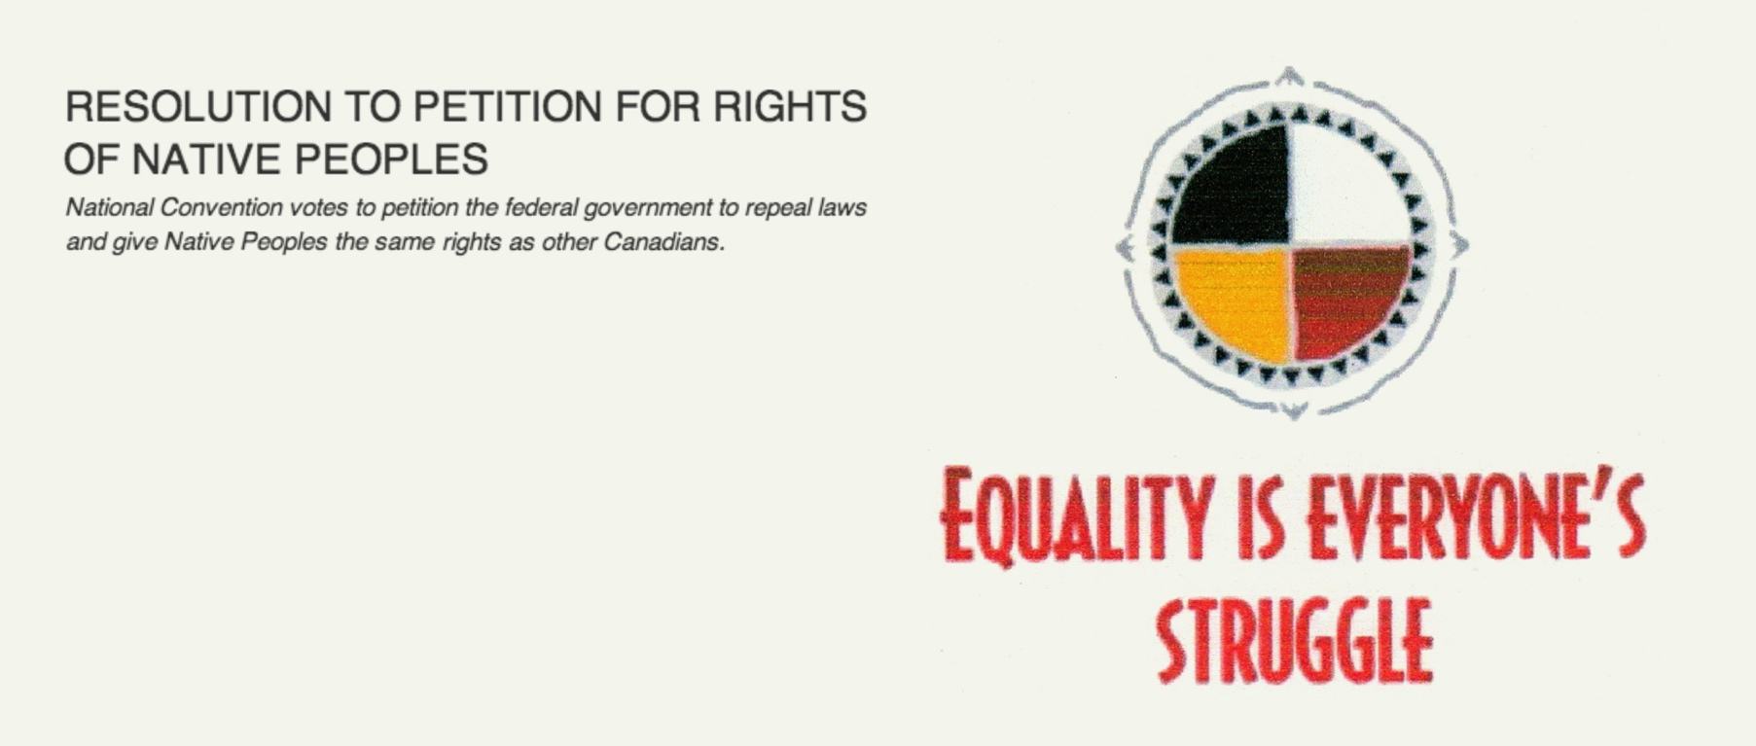
Notes:
Aboriginal rights have also been on the forefront of CUPE equality since the 1960s.

Slide 6
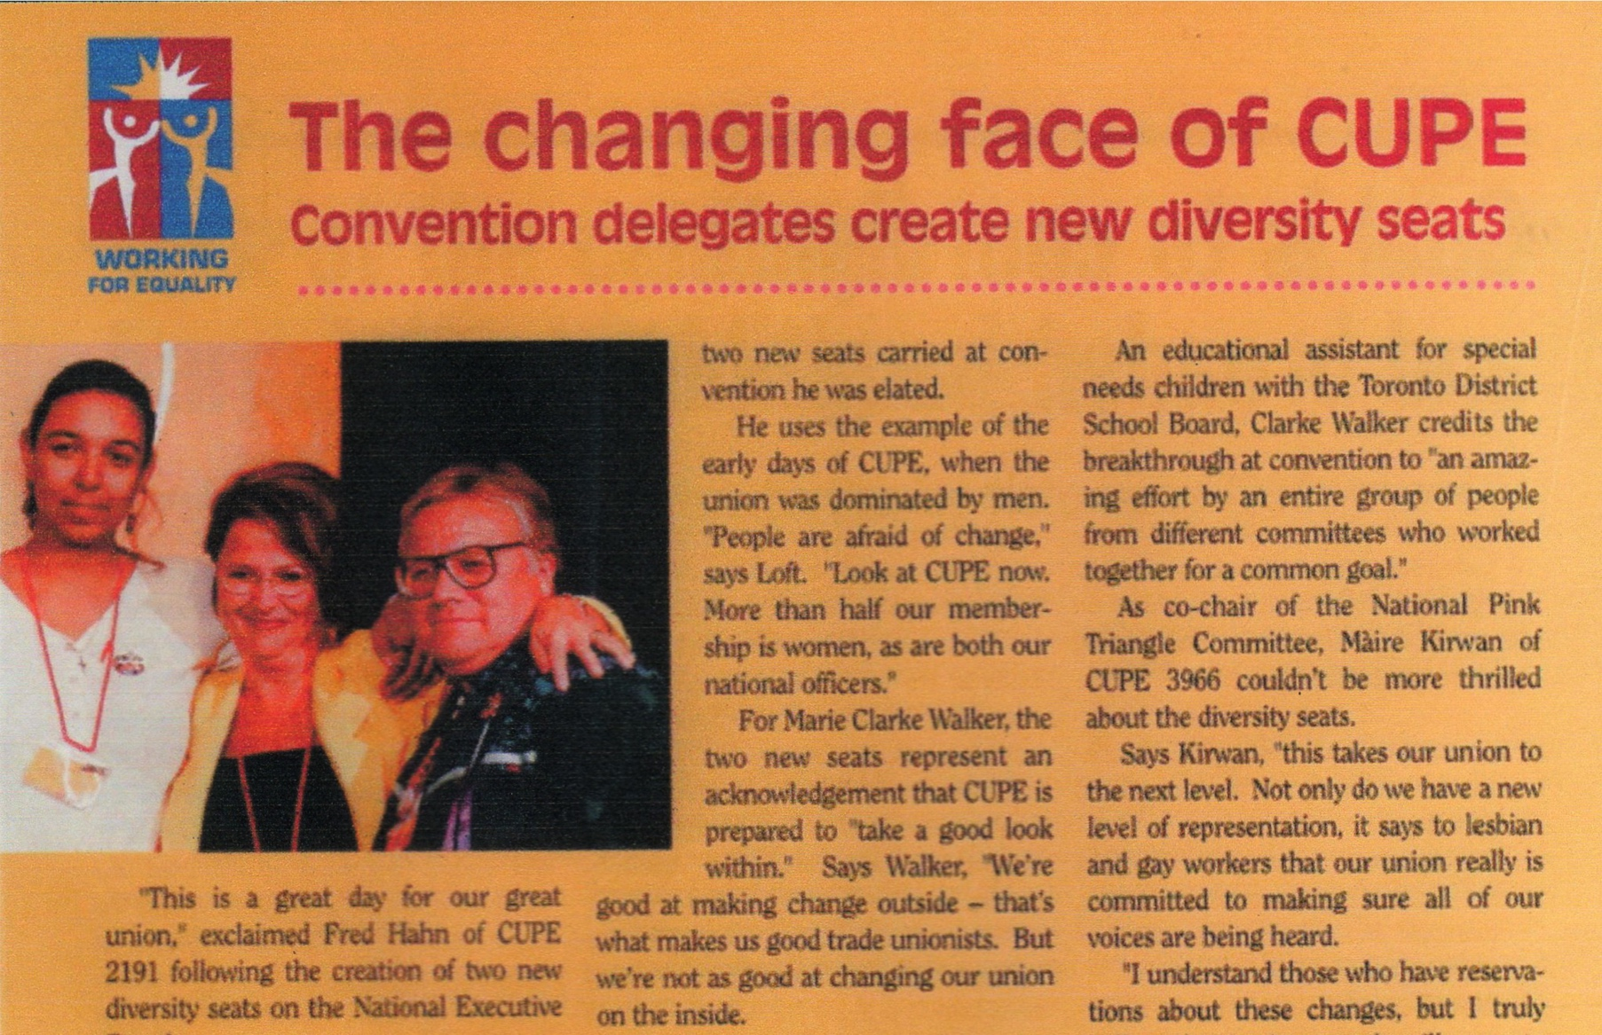
Notes:
As with every struggle, we make progress inside our union as well as outside, where we work and live.

Slide 7

Notes:
CUPE led one of the biggest wins for Aboriginal rights in Canada: the employment equity partnership agreement in Saskatchewan.

Slide 8
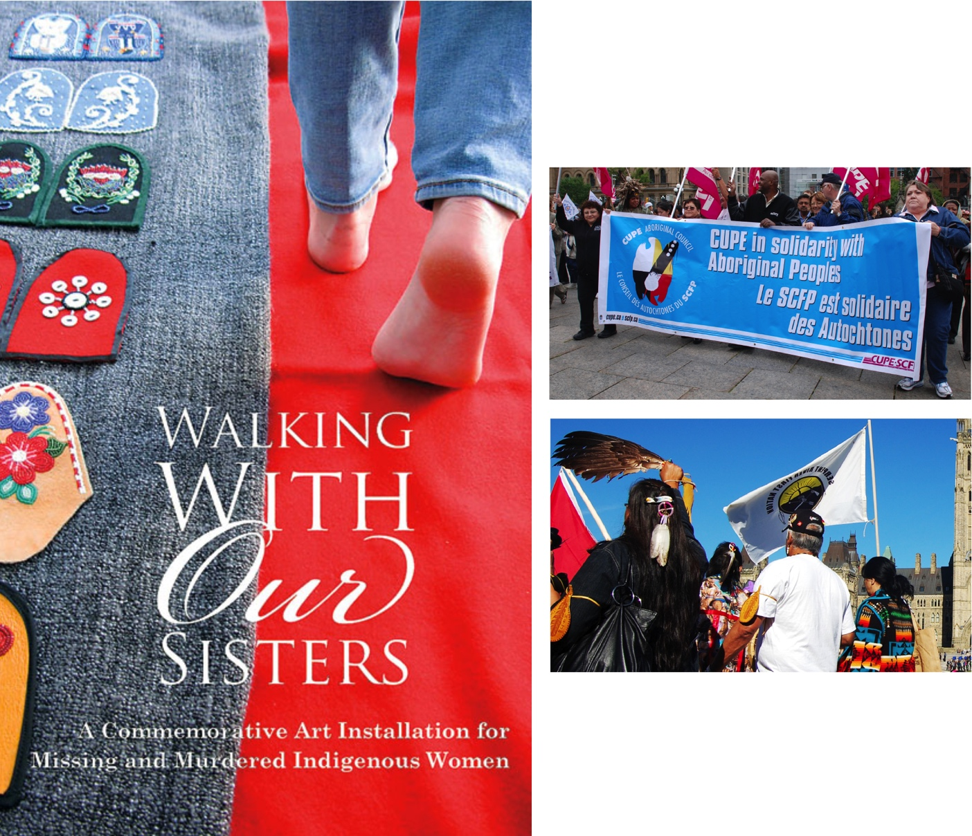
Notes:
And we’ve been a union leader in fighting alongside Aboriginal activists for safe drinking water, security for women and girls and other human rights.

Slide 9

Notes:
Our national membership survey and our human rights conference in 2015 identified challenges we to face as equality-seeking groups.

Slide 10

Notes:
We can be proud of our equality history, though we still have much work to do.

Slide 11
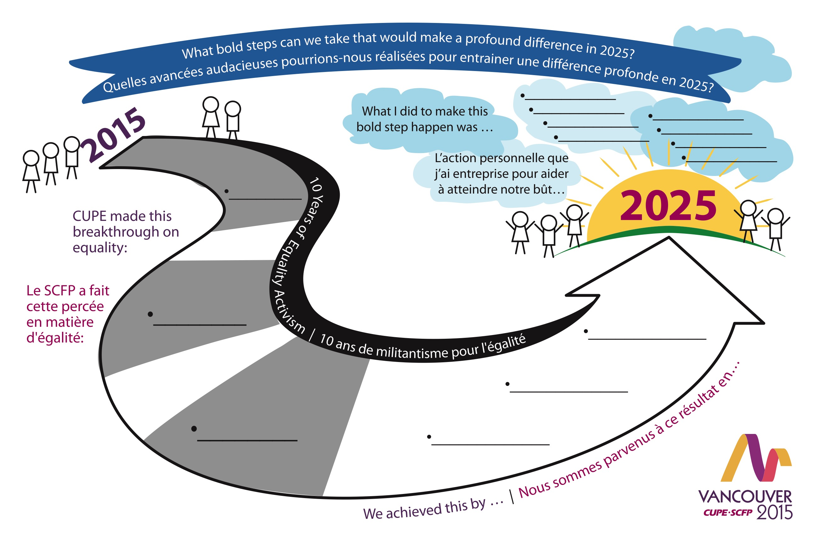
Activity sheet at convention forum November 2015

Slide 12
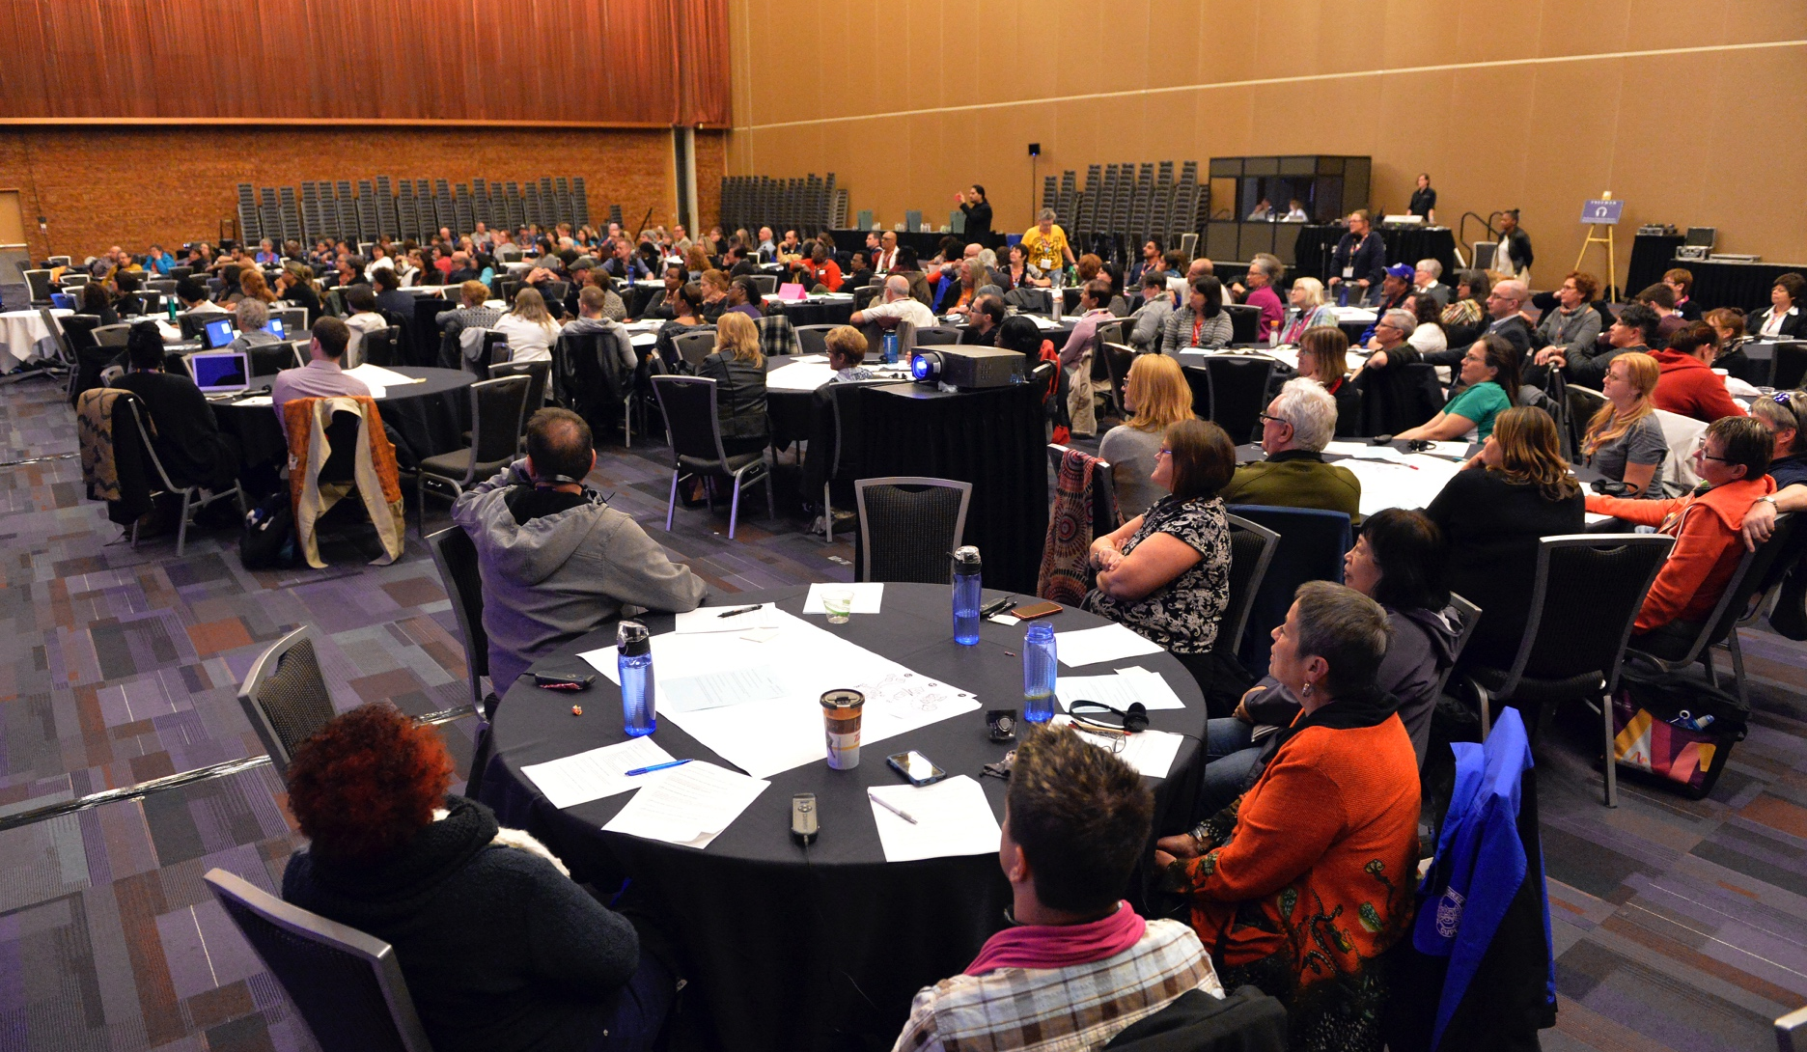
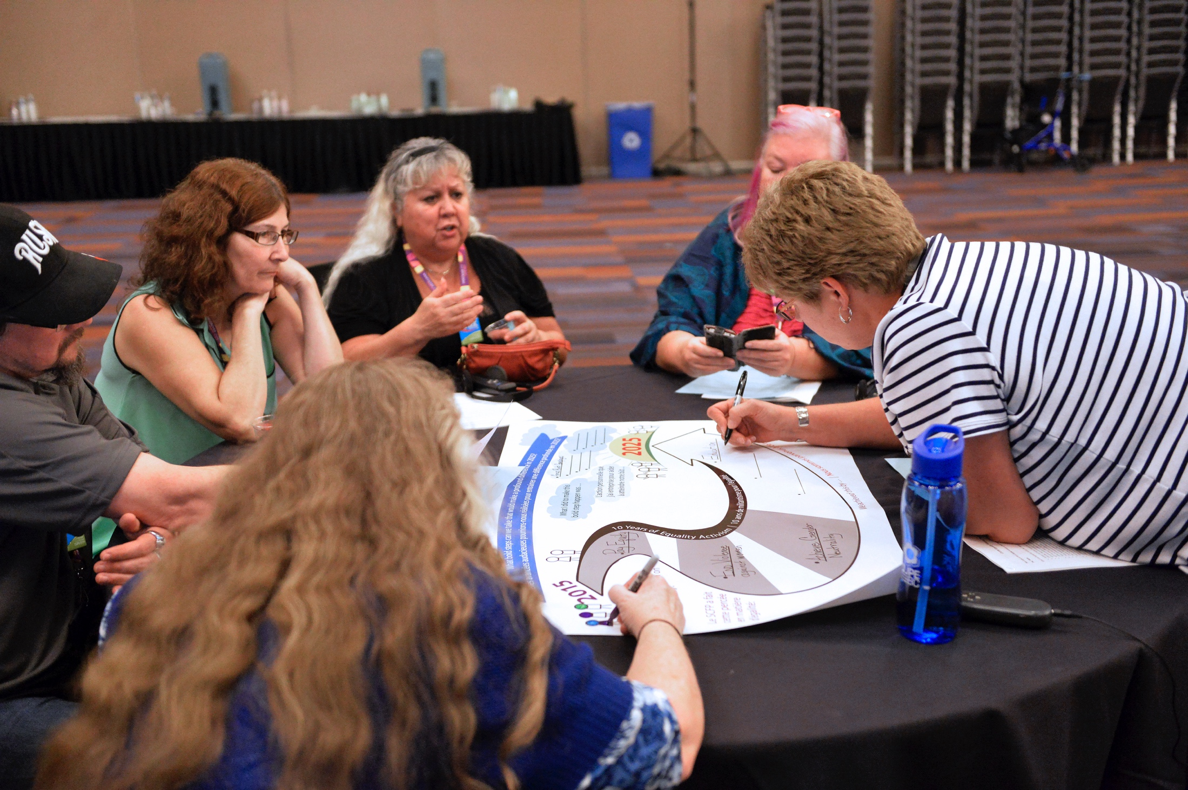

Slide 13
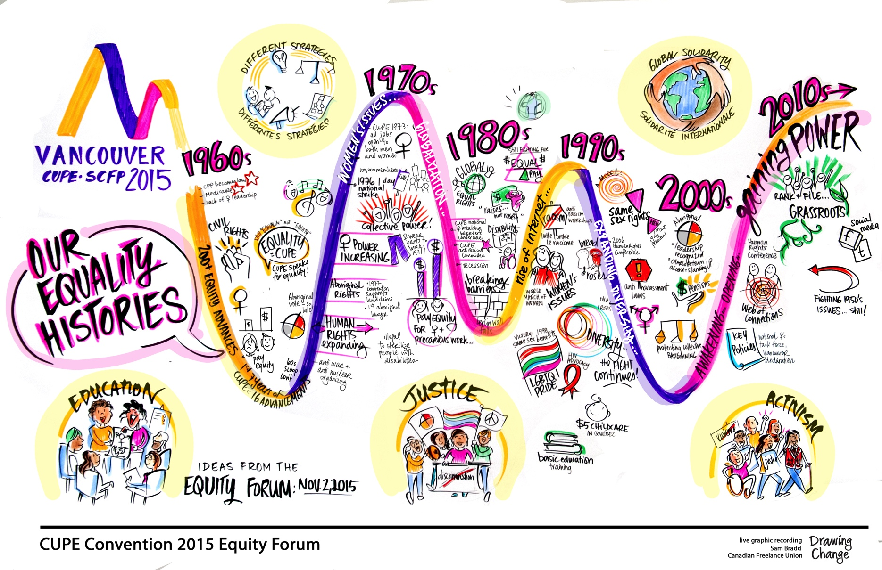
Image produced at convention equality forum

Slide 14
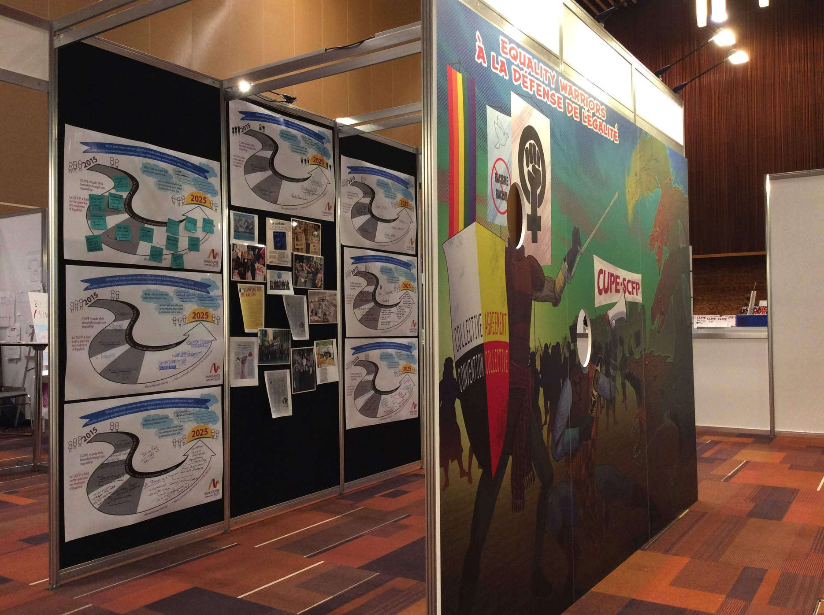
Some activity sheets posted in convention booth

Slide 15
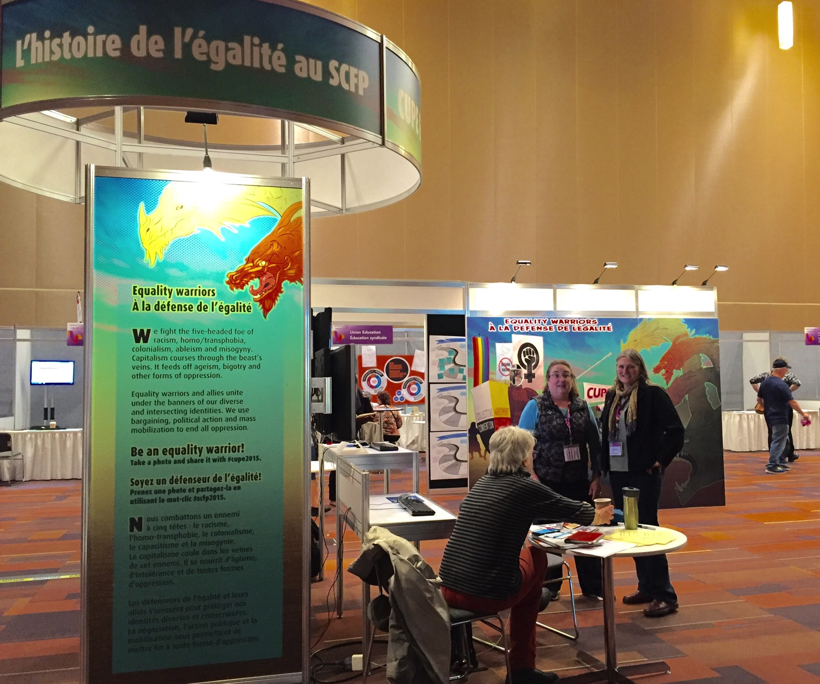
Notes:
Equality warriors: À la défense de l’égalité
We fight the five-headed foe of racism, homo/transphobia, colonialism, ableism and misogyny. Capitalism courses through the beast’s veins. It feeds off ageism, bigotry and other forms of oppression.
Equality warriors and allies unite under the banners of our diverse and intersecting identities. We use bargaining, political action and mass mobilization to end all oppression.
Be a warrior! Take a photo and share it with #cupe2015.
_____________
Nous luttons ensemble l'ennemi à cinq têtes : le racisme, l'homophobie et la transphobie, le colonialisme, le capacitisme et la misogynie. Le capitalisme coule dans les veines de la bête. Elle se nourrit d'âgisme, d'intolérance et d'autres formes d'oppression.
Les championnes et champions de l'égalité et nos alliés s'unissent sous les bannières de nos identités diverses et entrecroisées. Nous utilisons des outils de négociation, d'action politique et de mobilisation pour mettre fin à toute oppression.
Prenez une photo et partagez-la avec #scfp2015.

Slide 16
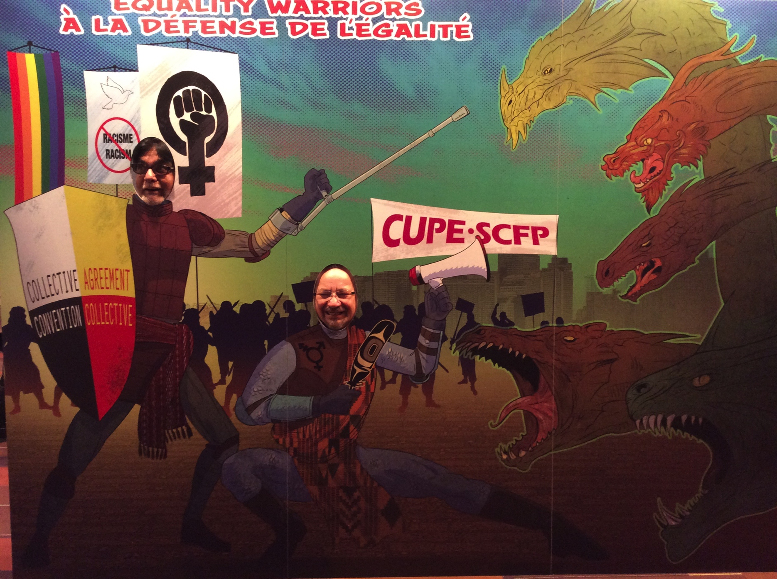
Equality warriors photo booth

Slide 17
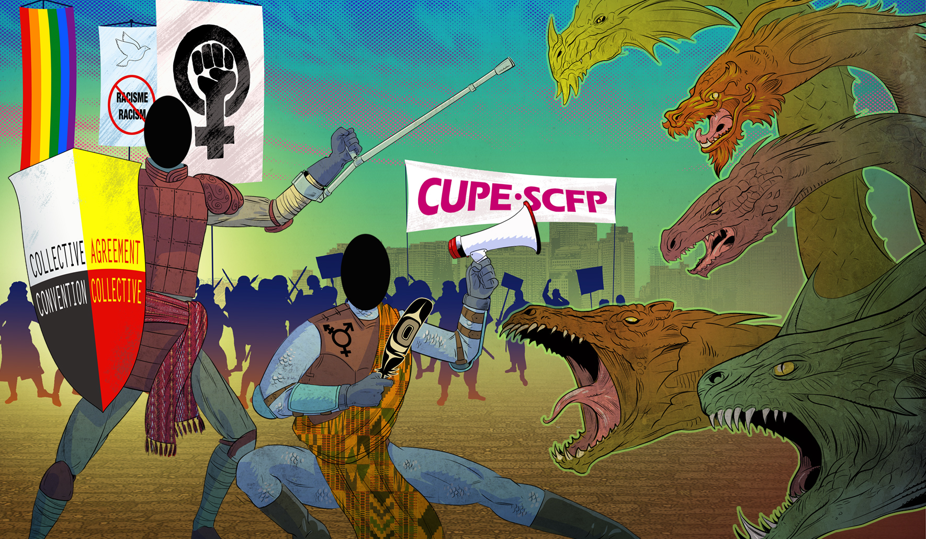

Slide 18
