Slide 1
Black from white
How Civil and Labor Rights Became Separate Freedoms with the U.S. Civil War
Cedric de Leon
Associate Professor of Sociology
Providence College

Slide 2
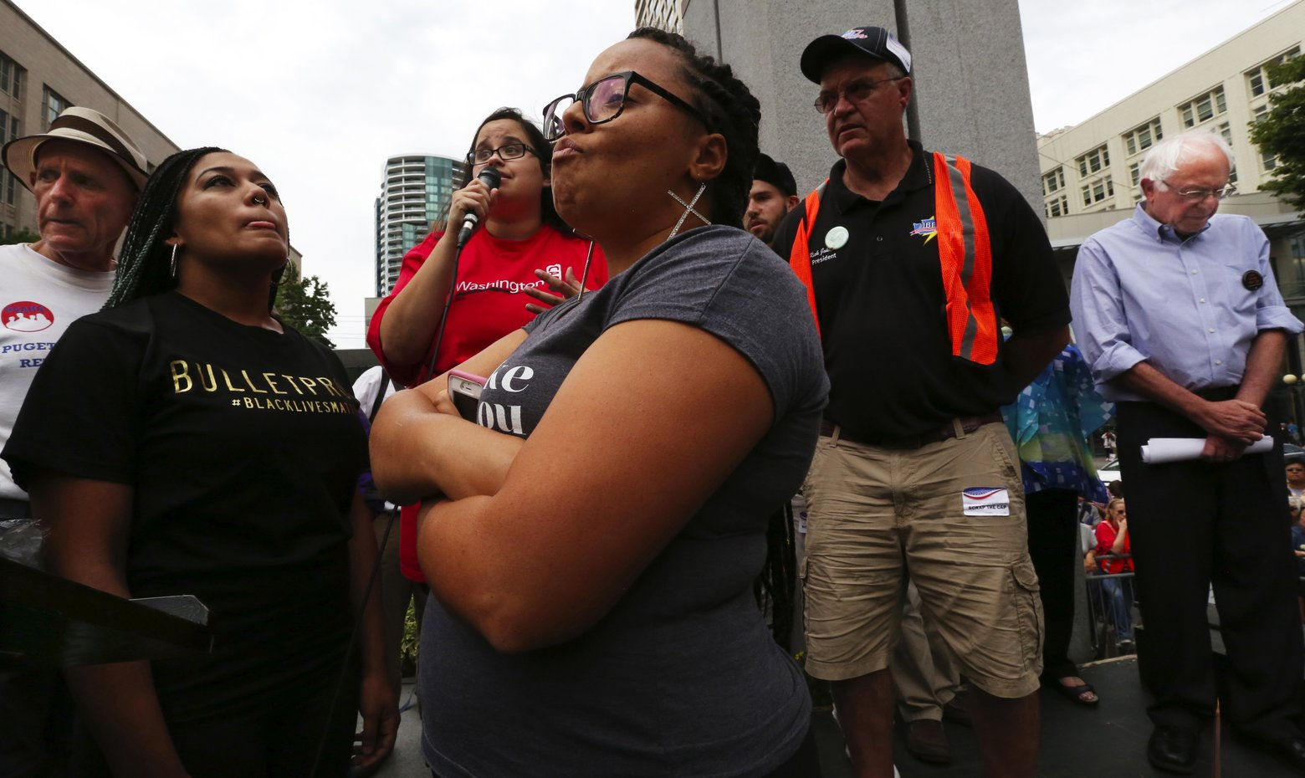
The Debacle in Seattle

Slide 3
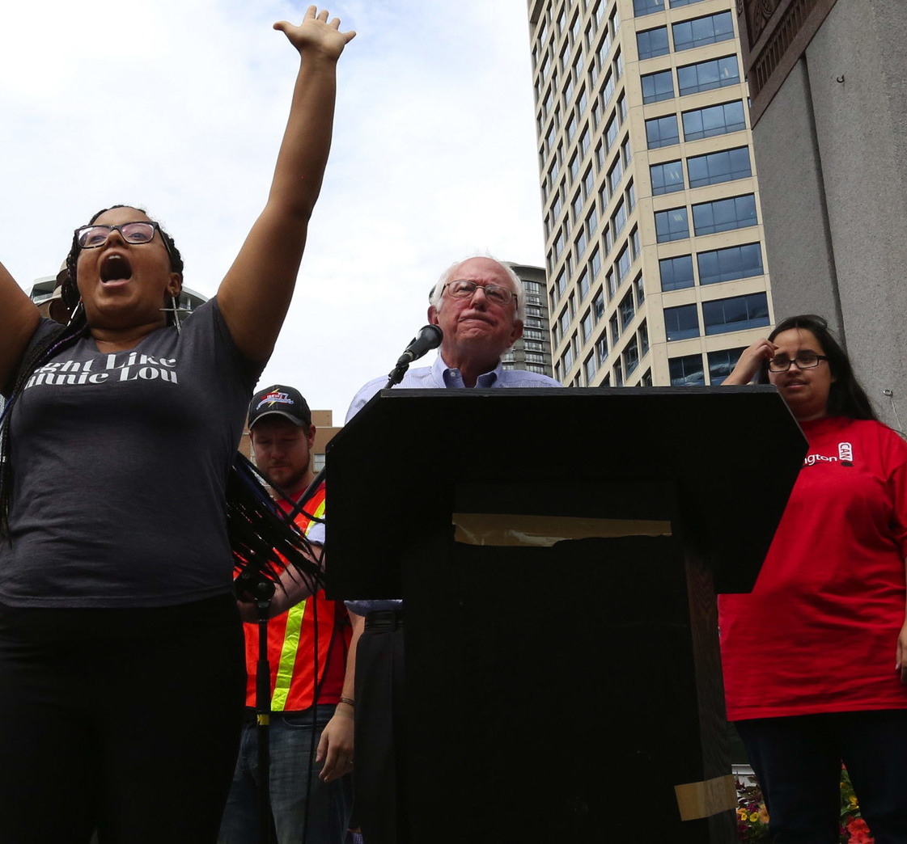
White Supremacist Liberalism
“I was going to tell Bernie how racist this city is, filled with its progressives, but you did it for me”
- Marissa Johnson

Slide 4
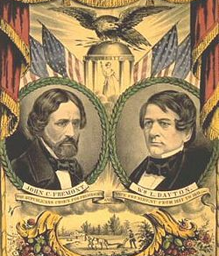
The Puzzle
Why did civil and labor rights become decoupled despite the high tide of Radical Republican hegemony?

Slide 5
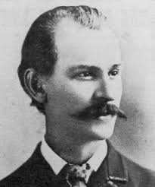
Two Clues
1868 Platform of the National Labor Union
Reservation of the public domain to actual settlers
Enforcement of the Eight Hour Laws

Slide 6
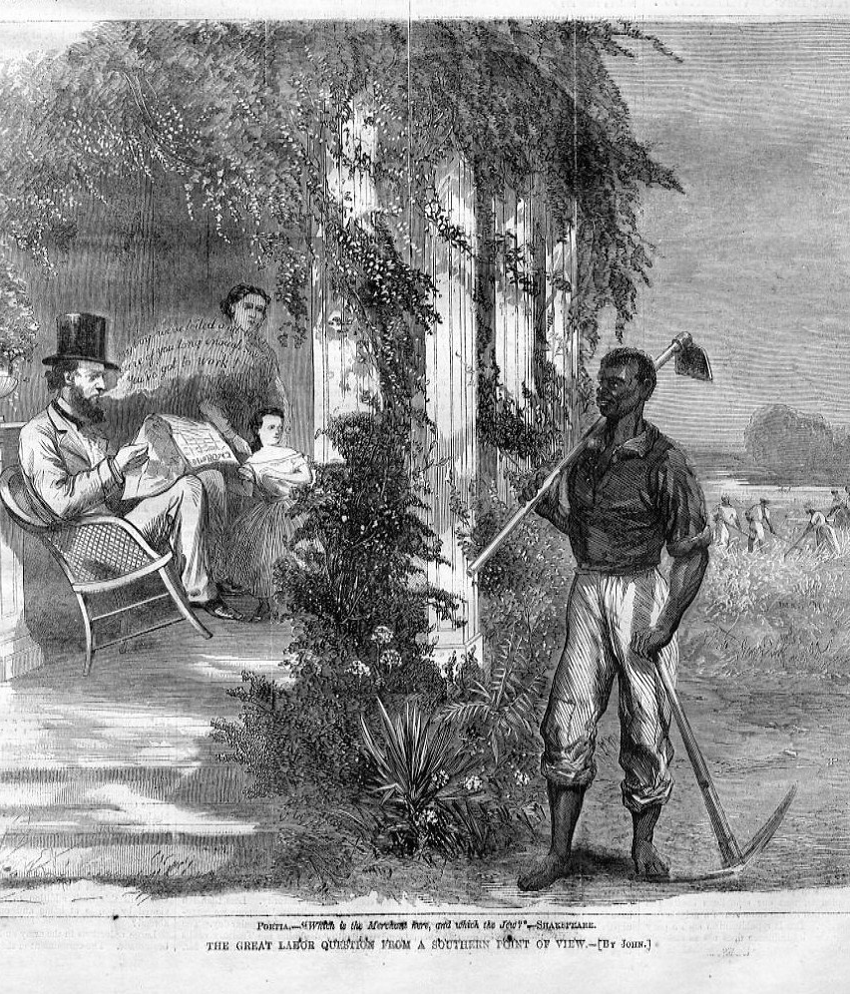
The Black Labor Question
Workers “had settled the black labor question, and now … would settle the white labor question…they had nothing to hope from the old parties.”
-Eduard Schlaeger
May 10, 1867

Slide 7
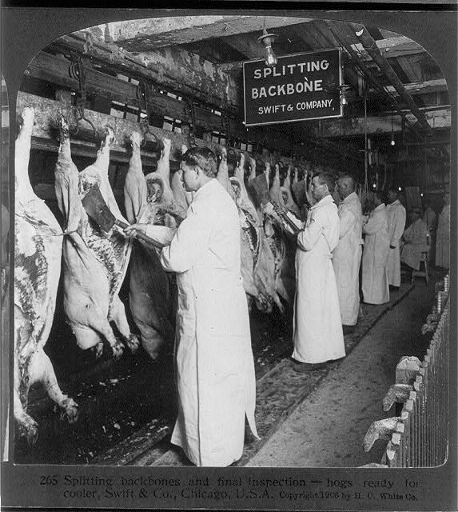
White Slaves
“That they lived in an age of freedom was true, but there were forms of slavery worse than that from which the black men had been released. There were thousands of white slaves, who spent their whole lives putting money in the pockets of a few, and were worse off in old age than in youth.”
-Chicago Workingmen’s Union March 18, 1872

Slide 8
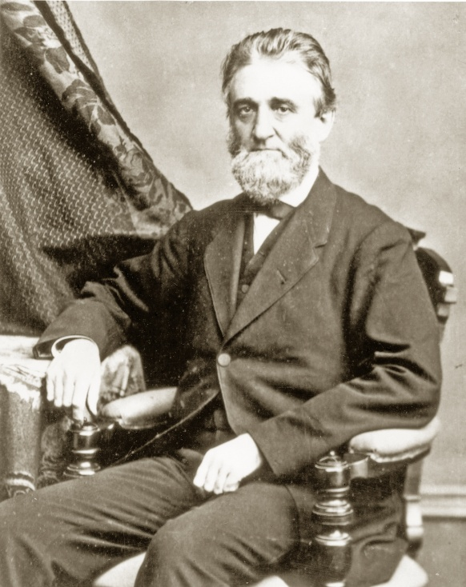
Right to Work and State Violence
“The right of every man in Chicago to work as many or as few hours as he pleases, and to be secure in the enjoyment of that right, must and will be protected. The right of every employer in Chicago to manage and control his own property and to make and carry out such bargains with his employes [sic] as he and they may agree to, must and will also be protected … rioters should be swept out of existence by a discharge of artillery.”
- Wilbur F. Storey
May 4, 1867

Slide 9
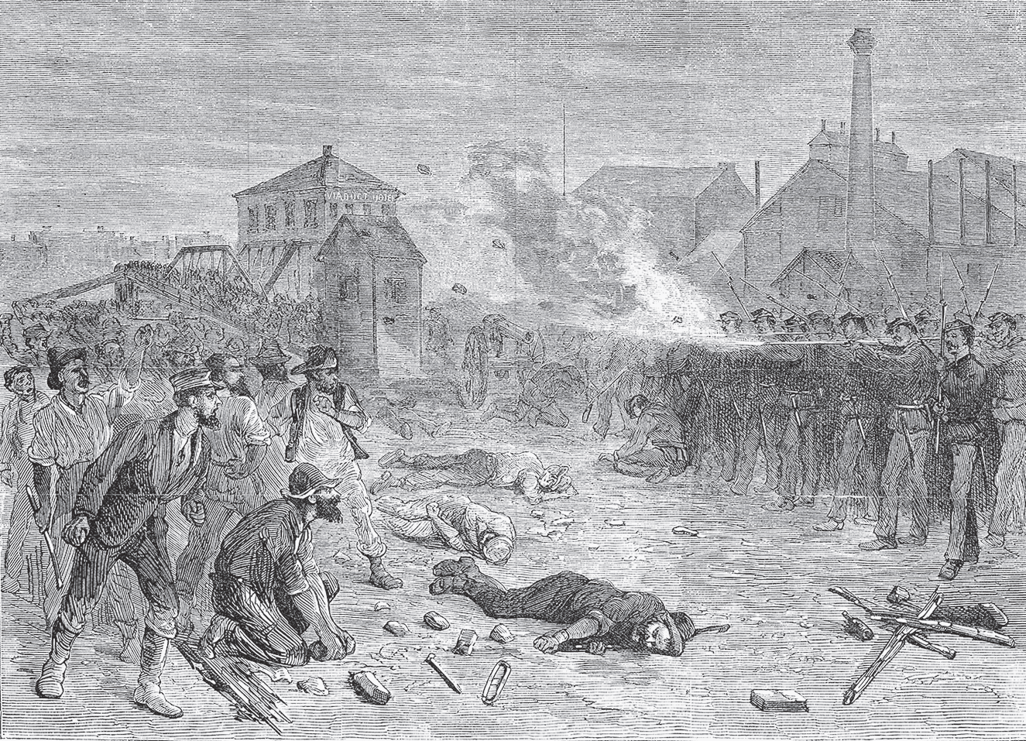
Battle of Halsted, August 1877

Slide 10
Summary
The double movement – of white workers’ turn away from black civil rights and of the party system’s turn away from white industrial workers – not only isolated the otherwise complementary interests of white and black working people, but also transformed them into competing political objectives.

Slide 11
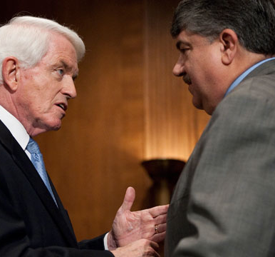
End our organizational isolation
U.S. Chamber of Commerce President Thomas Donohue and AFL-CIO President Richard Trumka agree that “American workers should have a first crack at available jobs”
(February 2013)

Slide 12
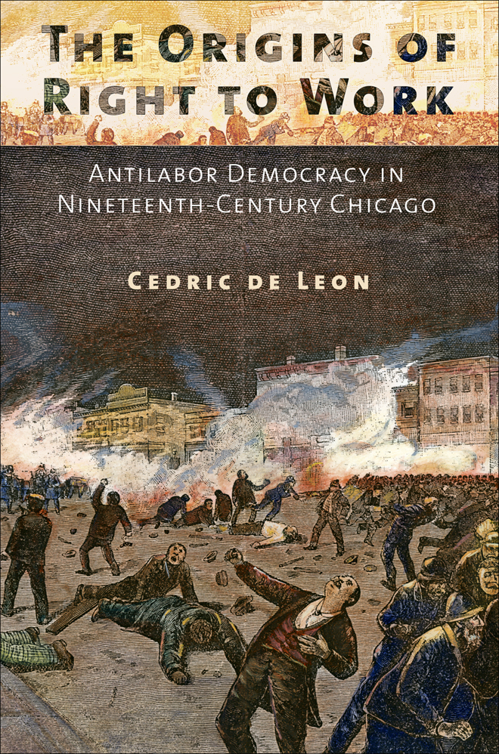
Thank you
Cedric de Leon
Associate Professor of Sociology
Providence College
cdeleon@providence.edu

