Slide 1
Connecting labor education with the community:
Co-designing a course
on organizing
Tom Marvin &
Amy Shackelford

Slide 2
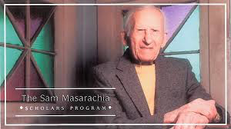
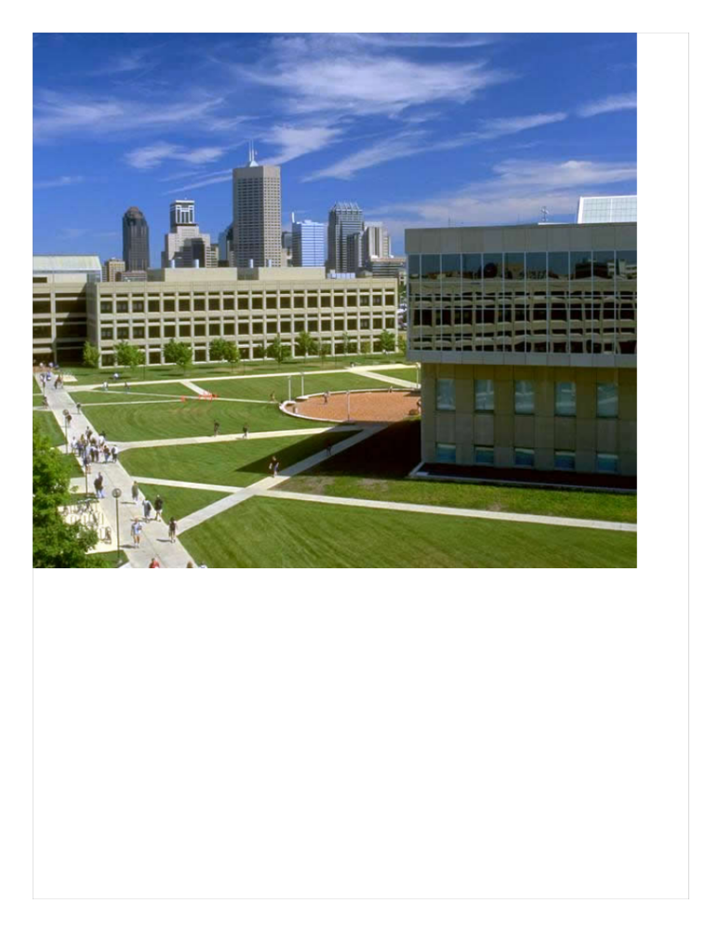
Original design of the program:
Introductory seminar
fall of first year
Advanced seminar each spring
Two internships of 150 hours each
The Sam Masarachia Scholars Program
Founded in 2000 to honor Sam’s achievements in labor and community organizing
Sam organized for the Steelworkers from 1936-1964
Became a community organizer in Fountain Square after retirement
Notes:
Ironies: I object to the Koch brothers buying higher ed, but here's one way to fight back.
Keeping my eye on the stock market as we undermine capitalist hegemony

Slide 3
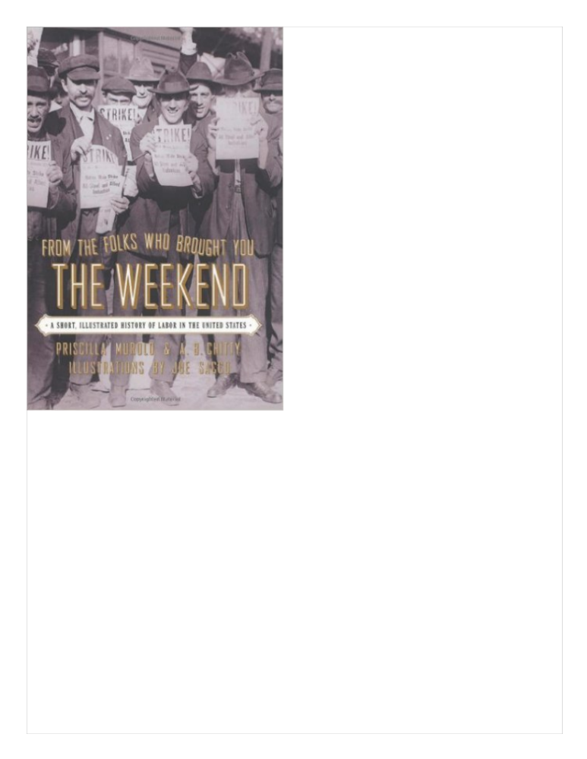
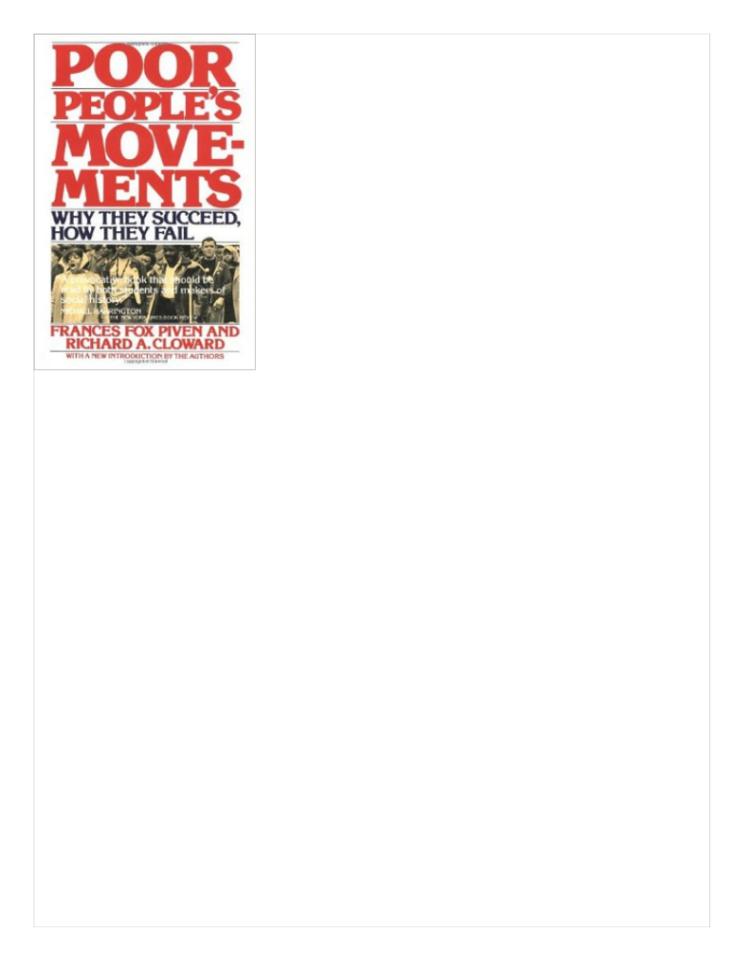
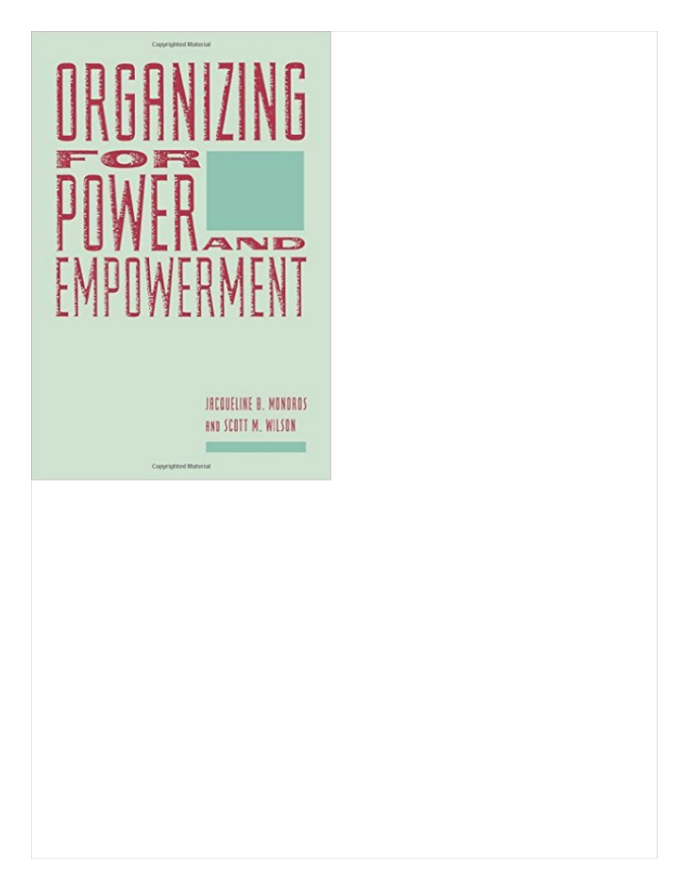
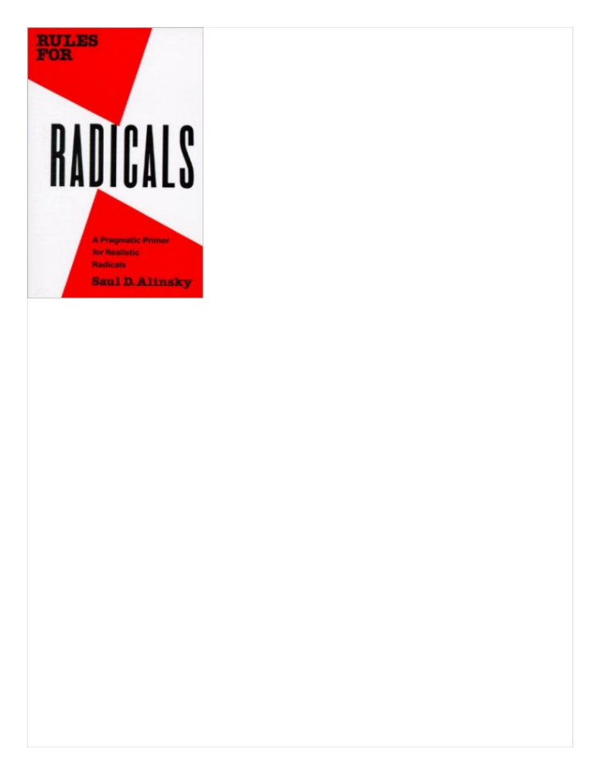
First-Year Seminar
2001-2005
Professor Jim Wallihan
Reading, writing and discussion
Field trips to talk with organizers
  SEIU Justice for Janitors
Industry visits:
  Chrysler foundry
  Visteon (Ford)
  International Harvester
  (All now closed)
Notes:
Jim Wallihan and early board members --
academics and union people -- created program
"Graveyard tour" of local heavy industry --
I had to quit -- I was feeling like a jinx.

Slide 4
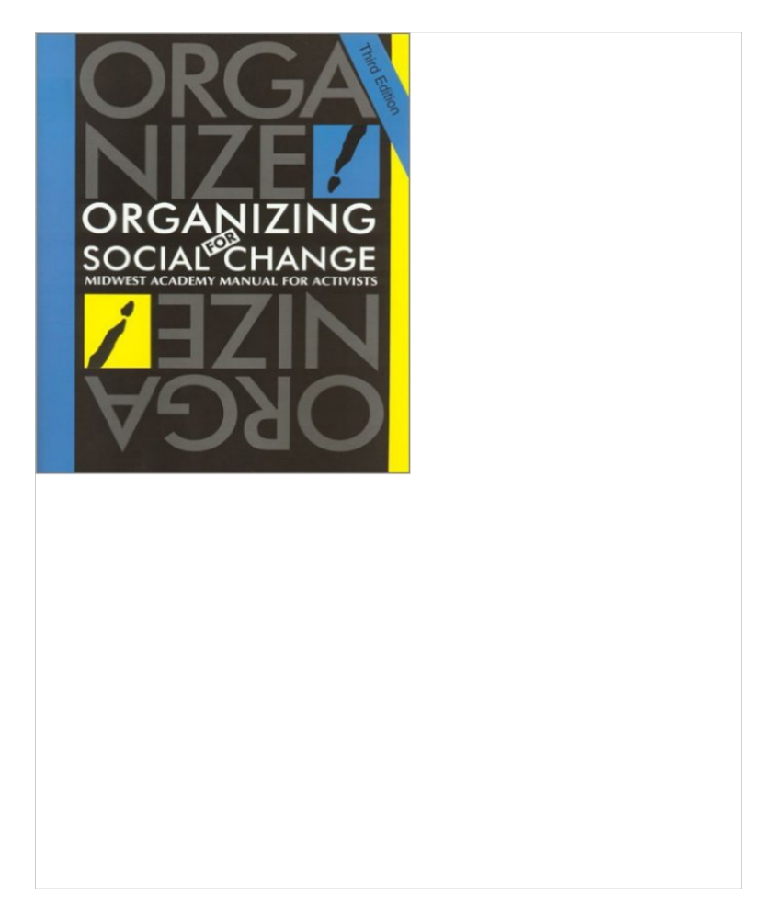
American Studies A 303:
Organizing for Social Action
2005-2006
Some new books
New emphasis on worker culture especially music
Detailed study of the IWW
Still a traditional seminar with weak ties to the community
Notes:
My turn: English and American Studies background
Kept many of Jim's books.
Desire to better prepare students for internships
Midwest manual

Slide 5
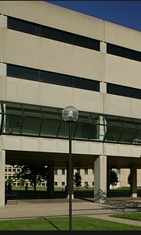
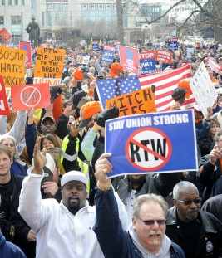
Bridging the University-Labor Gap
Service learning w/ local unions & community groups
Students dedicate 3-4 hours per week
Participate in all aspects of the work
Often take on a special project
Keep a journal
Write a reflective report connecting experiences with class readings & discussions
“The Concrete Tower” –the urban university
The Struggles of Workers
in a Red State
Notes:
I can walk from IUPUI to the statehouse in fifteen minutes but can I connect the concrete tower w/ worker struggles?
Reading ABOUT it isn't enough.
Long-term mutual relationships w/ labor partners.

Slide 6
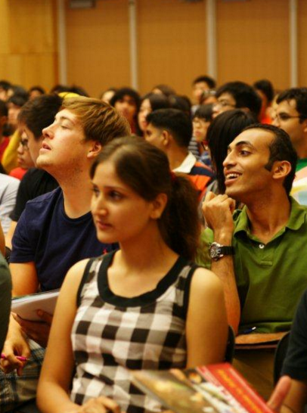
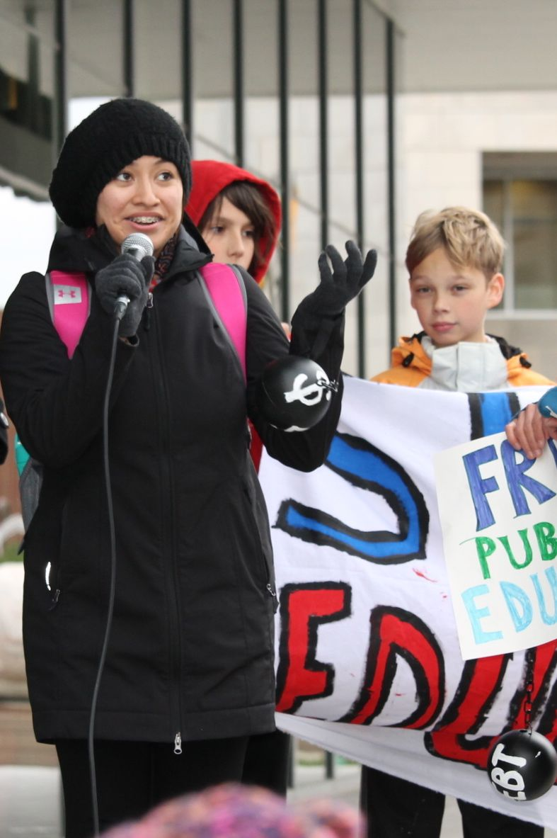
Bridging the Student-Organizer Gap
Lectures encourage passivity.
Basic Skills:
One-on-ones
Tabling
Planning & facilitating meetings
Recruiting new members
Developing leaders
Campaign strategy
Activist education provides skills for a lifetime of
social change work.
Notes:
Early recruits organized spirit T-shirt day in HS.
Local bias against organizing/confrontation
Class project: safe, familiar, convenient, resources

Slide 7
Parking Privatization at IUPUI
The ideal issue for our first class project 2012-2013
Majority commuter campus already plagued by high prices and lack of spaces at peak hours.
Privatization plan trades seventy-five years of parking revenue for a one-time payment.
Recent unsuccessful bid to stop parking privatization at Ohio State University.
Campus location convenient & familiar for novices.
Notes:
Freshman com: had to ban parking as topic.
Privatization: solution for non-existent problem.

Slide 8
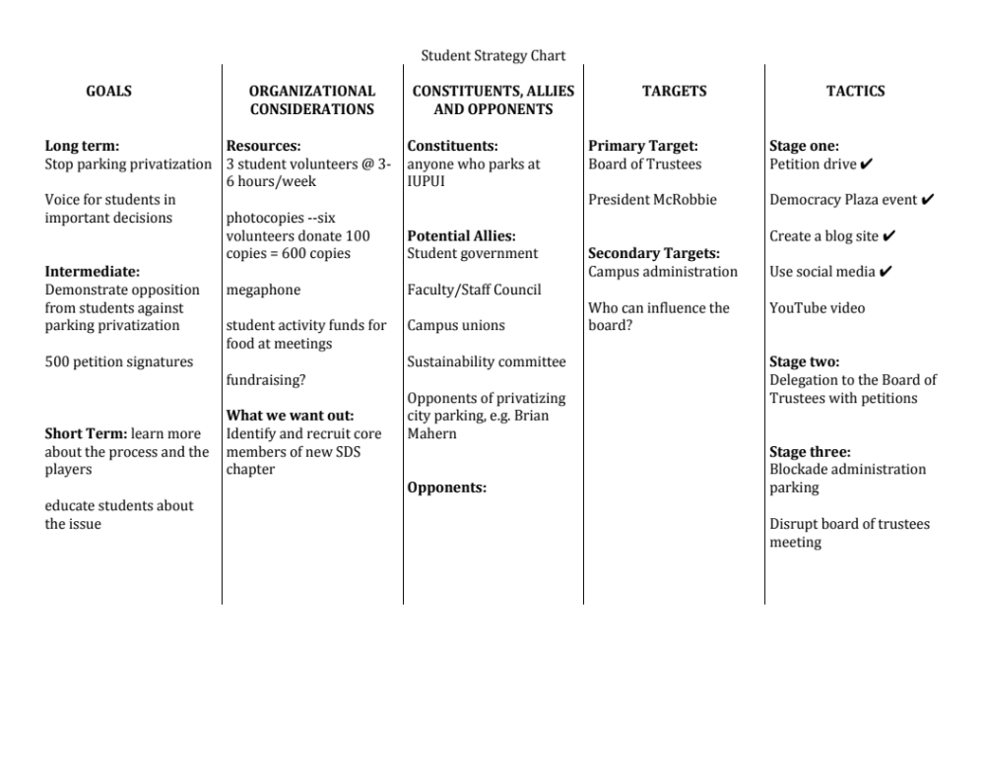
Notes:
Midwest Manual chart of campaign
2nd column: resources & goal for org.
Final column: plan for escalation

Slide 9
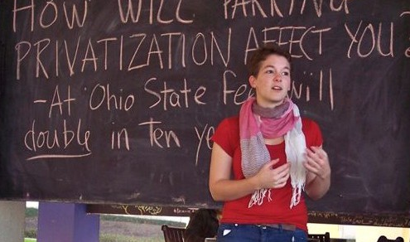
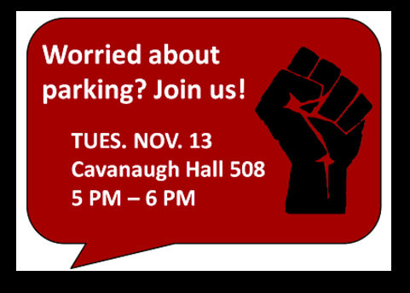

Early on the campaign took advantage of existing opportunities to reach students.
“Democracy Plaza” is a series of conversations on topical issues sponsored by student government.
Notes:
Ruth's progress: shy & reluctant
rapping at the end of the garage tube
confident spokesperson

Slide 10
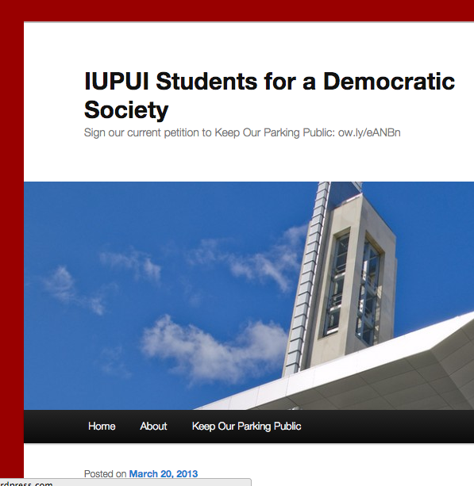
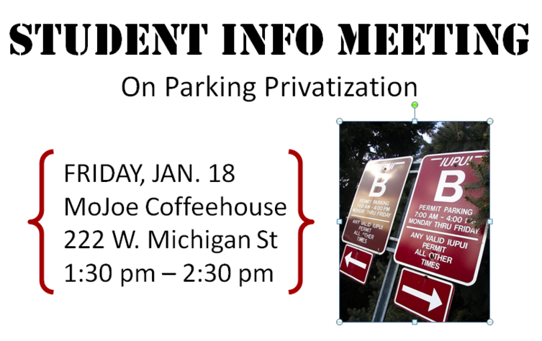
The Learning Continues after the Class is Over
Students kept organizing over winter break and into the spring semester.
The SDS blog featured an analysis by an economics professor and provided a source of quotes for the media.
Notes:
Best part of real project: doesn't quit when term does

Slide 11
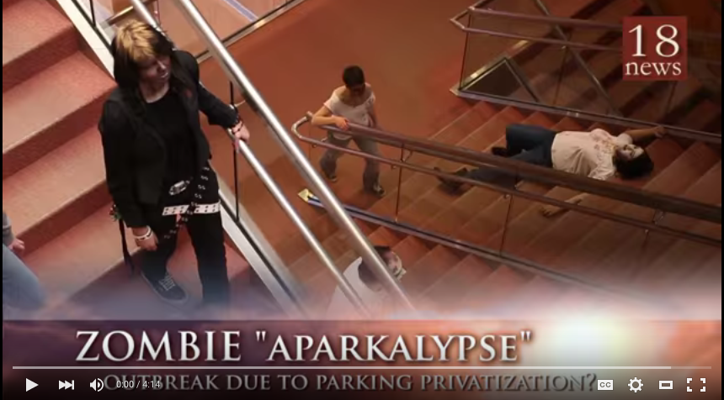
They even made a YouTube video comparing parking privatization to a zombie apocalypse.
Notes:
We got some art students involved
pretty good quality spoof of zombie movie w/ clear anti-privatization message.
1875 hits on YouTube.

Slide 12
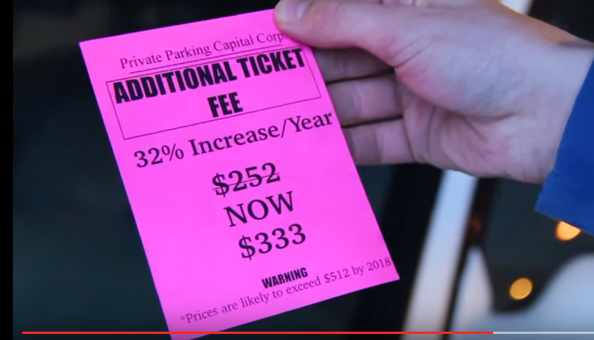
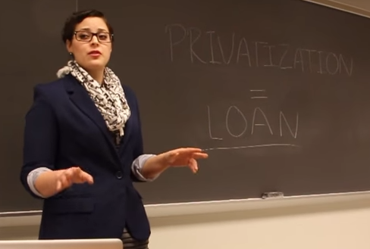
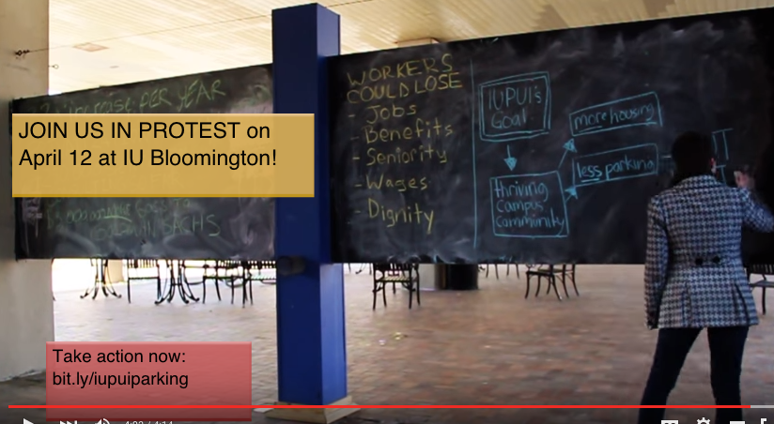
In addition to dodging zombies, our hapless hero learns why privatization is just like a loan and discovers that parking will be much more expensive next year.
Notes:
Basic educate -- agitate -- organize formula.

Slide 13
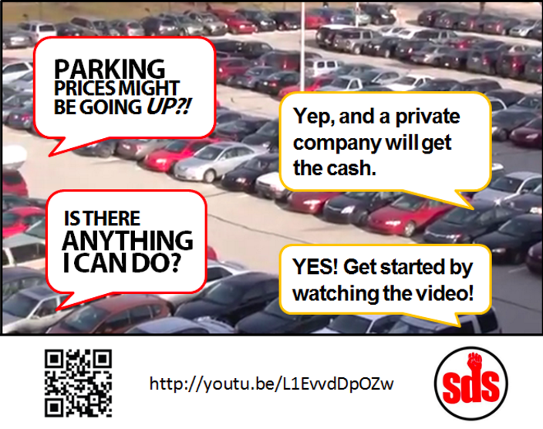
Promoting the video and the petition on social media.

Slide 14

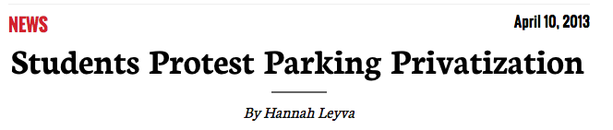
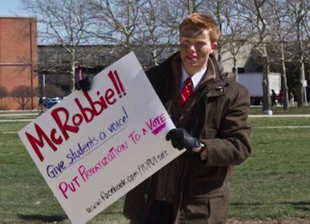
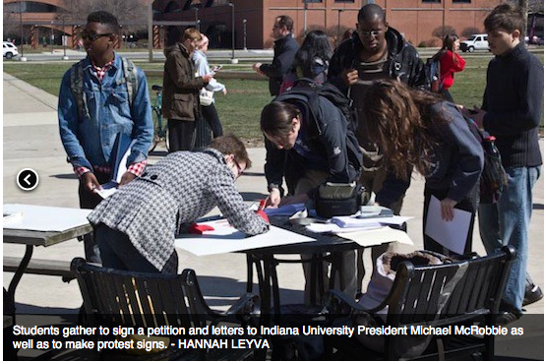
Notes:
Keeping pressure up during spring
taking petition outside

Slide 15
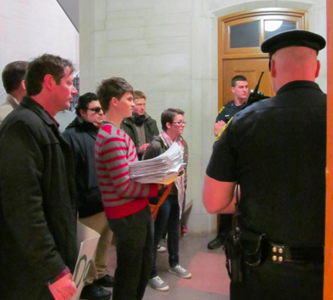
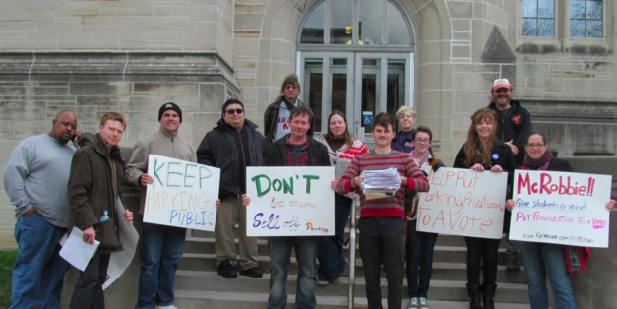
April 13, 2013: Delivering 2000+ Petitions to President McRobbie in Bloomington
October 13, 2013: IU announces decision not to privatize parking
Notes:
Working class spring break trip 1 1/2 hours south
From the concrete tower to the limestone halls of power.

Slide 16
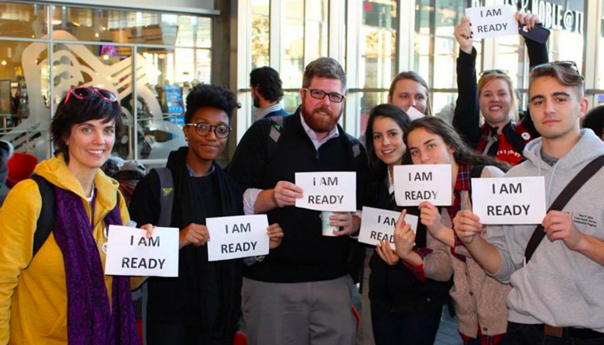
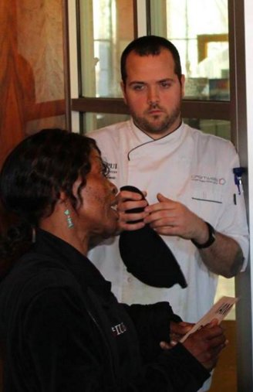
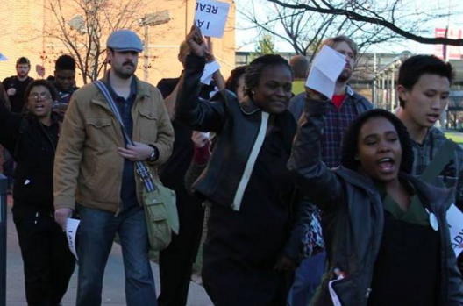
Class Project 2015
Organizing student support for campus food-service workers’ contract campaign.
Notes:
Prior involvement in first contract campaign 2011-12.
Win: $2.20/hr. wage over 5 years 40 hour week
health and disability insurance

Slide 17
Are we bridging the gaps?
Ask the people who work with our students!
Eight local organizers from:
  AFSCME
  American Friends Service Committee
  Central Indiana Jobs with Justice
  Indiana State Teachers Association
  Martin Luther King, Jr. Service Center
  Sierra Club
  SEIU
  UNITE/HERE

Slide 18
Review Process
Syllabus
Role-playing scenarios
Student journals and reflective papers

Slide 19
Review Process
Questions for Organizers about the Masarachia curriculum
Before reviewing the current curriculum:
What skills do you want students to have before they begin an internship with your organization?
How can these skills be taught?
What knowledge do students need before they begin working with your organization?
What books/articles/tools do you find essential to your organizing work?
What lessons/resources/skills do you have to contribute to the class?

Slide 20
Review Process
After reviewing current curriculum:
What is the best way classroom instruction can prepare students to complete service hours at your organization?
How effective are the role-playing exercises in building organizing skills? What suggestions do you have for improving them?
Do you believe the people your organization works with are well represented in the curriculum?
If not, do you have suggestions for incorporating their experiences?
What lessons do you think should be added to the curriculum?

Slide 21
Results
Focus group endorsed these aspects of the current course:
  Role playing scenarios based on real, local, recent campaigns
  Service learning experience & reflection
  Labor History
  History & theory of organizing
Suggestions:
  Update readings with current events, e.g. Black Lives Matter
  Media training
  How to deal with privilege, racism, and oppression within an organization, self, and community

Slide 22
Community Engagement
Add service-learning sites that represent more diverse populations
Add sites that address neighborhood issues
Add sites that use education as activism
Engage with leaders who are real people and don’t necessarily speak organizer jargon
Open the course up to nonstudents – local residents who do organizing but do not realize or call it organizing

Slide 23
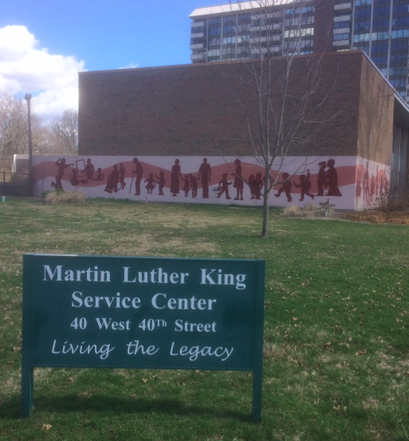
Changes for Fall 2016
Move the course off campus
Invite community participation:
  High school students
  Neighborhood residents
Frequent visits from local organizers
New Partners:
  MLK Service Center
  Khephrw Institute
  Peace Learning Center
  School for Community Learning

Slide 24
THANK YOU!
Focus group members:
Megan Anderson, Sierra Club
Mary Kate Dugan, alumna & Central Indiana Jobs with Justice
Allison Luthe, Martin Luther King Service Center
Stuart Mora, UNITE/HERE
Paul Nappier, SEIU
Erin Polley, American Friends Service Committee
Ed Ramthun, AFSCME
Becky Smith, Indiana State Teachers Association
IUPUI Center for Service and Learning for financial support & advice

