Slide 1

Training & Education in the Domestic Work Industry
Defining Goals and Understanding Impact

Slide 2
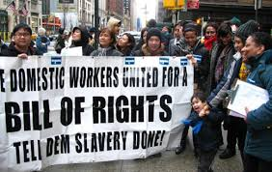
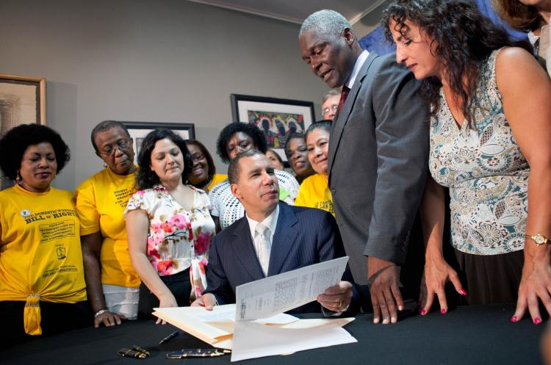
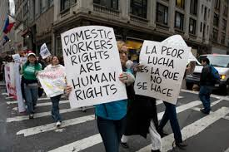

Slide 3
Panel members
Devi Karki, Indira Dhemjong
Adhikaar
Bernarda Espinoza, Margarita Ruiz, Maricela Sosa
Beyond Care
Christine Lewis
Domestic Workers United
Linda Oalican
Damayan
Christine Lewis
Domestic Workers United
KC Wagner Worker Institute at Cornell
Sanjay Pinto Worker Institute at Cornell, Rutgers SMLR

Slide 4
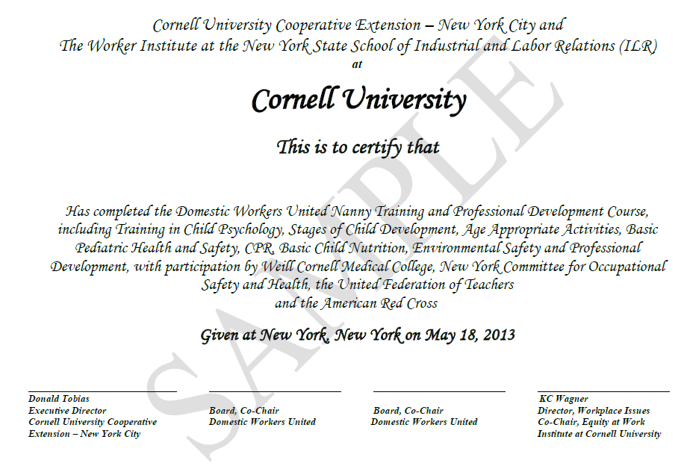
Nanny training snapshot
35-hour trainings covering childcare and worker rights skill building
Since 2007, over 350 participants have received 7,500 hours of training and a certificate of attendance from Cornell ILR and Cornell Cooperative Extension

Slide 5




Partners
Nanny trainings have grown out of the vision of NYC domestic worker organizations Domestic Workers United, Adhikaar, Damayan, Beyond Care and the National Domestic Workers Alliance (NDWA).
Educational partners and allies include Cornell Weill Medical, the Red Cross, NYCOSH, UFT Teachers Center, and local community organizations with expertise.

Slide 6
Leveraging institutional power
Worker Institute core value:
  “worker rights and collective representation are vital to a fair economy, robust democracy and just society”
Nanny trainings:
  Draw on university experience in adult education to provide needed skills for domestic workers
  Leverage the university’s institutional credibility
  Provide support for a key programmatic area of local worker centers
  Create an opportunity to collaborate with other educators
  Through related research, provide a basis for assessing impact

Slide 7
Assessing impact

Slide 8

Connecting the dots…
How can training and education in the domestic work industry…
help to improve conditions for people whose labor is devalued?
build community among people who face isolation at the workplace?
provide one set of resources for better navigating a context marked by exclusions based on race?

Slide 9
Different dimensions of education
Knowledge and skills
  Nutrition
  Child development
  Child safety
Awareness of basic rights
  Strategies for negotiating with employers
  Familiarity with provisions of NY Domestic Worker Bill of Rights
Political education
  Understanding the role of organizing in building power
  Developing an analysis of inequality and its causes

Slide 10
Key research questions
1. What do participants learn?
  Childcare-related skills
  Rights and negotiation strategies
2. How does training affect employability?
  Ability to find work
  Ability to negotiate better terms

Slide 11
Learning outcomes
Self-assessments
  Participants rate what they know before and after the entire nanny training program
Pre- and post- quizzes
  Administered at the beginning and end of each session
  For workers: means of tracking learning
  For instructors: means of clarifying learning objectives
  For researchers: means of assessing learning outcomes in a more “objective” way
Preliminary results from
a recent nanny training

Slide 12
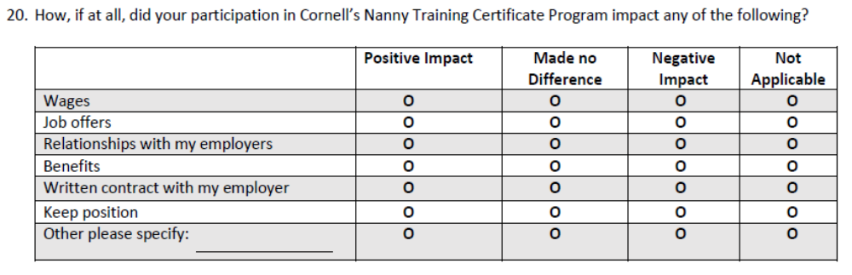
Implications for employability
Surveys during the trainings, and follow-up surveys several months later
  Objective comparison of wages and employment status at the time of the trainings and afterwards.
  In the follow-up surveys, ask participants to rate which skills were most valuable to them and how training shaped their subsequent experience in the industry

Slide 13
What is at stake?
For nannies?
  improved working conditions
For employers?
  higher-quality services
For worker organizations?
  base building and, potentially, income generation
For labor educators?
  reaching an underserved segment of the workforce
For policymakers?
  promoting improved job quality & quality of services in a growing sector of the economy
Notes:
As far as understanding the role of training in the domestic work industry

Slide 14

A piece of a larger puzzle
Not just about worker education
  Education of employers is also crucially important.
Not just about individual skills and awareness
  Need broader education and culture change aimed at placing greater value on caregiving work;
  public supports that enable employers to pay a higher wage;
  mechanisms to ensure that training brings a payoff;
  minimum wage and other policies that mandate improved conditions across low-wage industries
Notes:
We want to be very careful not to play into arguments that emphasize individual attributes to the exclusion of broader structural issues.
Training might help to give people a leg up in this industry, but human capital endowments don’t go anywhere close to explaining why conditions are so challenging for workers in this industry.
So we also need to think about a broader set of efforts aimed at lifting up the importance of this work.

